Slide 1
Zurich HDAWG Python Gui • PCB Layout with Eagle
Richard McManus
Research Presentation (II Credits)
Snider Group
Fall 2023

Slide 2
Zurich HDAWG GUI (AWG_gUI.py)

Slide 3
Background
AWG
AWG Trigger 1 Bit
12 Positive Ramps
Clocking Board
24 +/- Ramps
FPGA program bit-stream download (JTAG)
-IO 16 Bit (In/Out)
-Mem/Write (Out)
-PC Out 16 Bit
-Reset 1 Bit In
0 - 1.8v <-> +/-0.7V
0-1.8v <-> 0 – 1.2 V
PC
FPGA
Level Shifting
MIPS
FPGA upload program results after program is completed (JTAG)
Power Supply
Power Supply

Slide 4
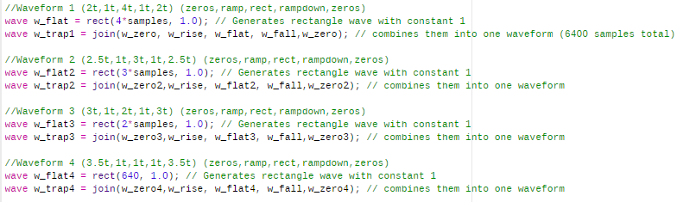
Spring 2021
Jack Bannon
LabOne Interface
Hardcoded values
Cut and joined ramp and rectangular waves

Slide 5
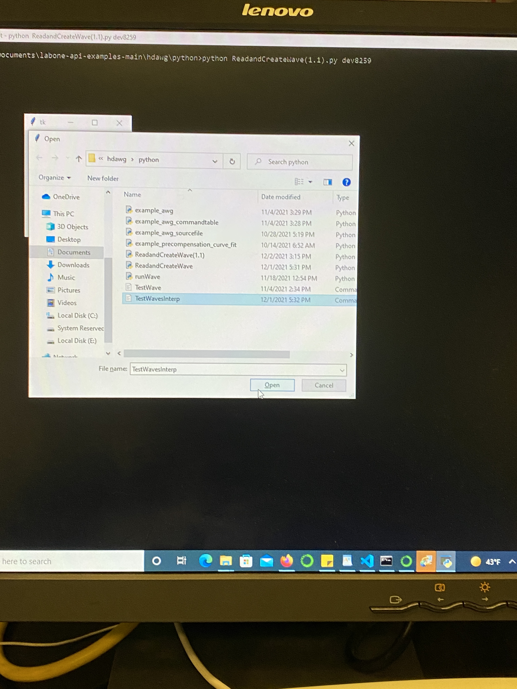
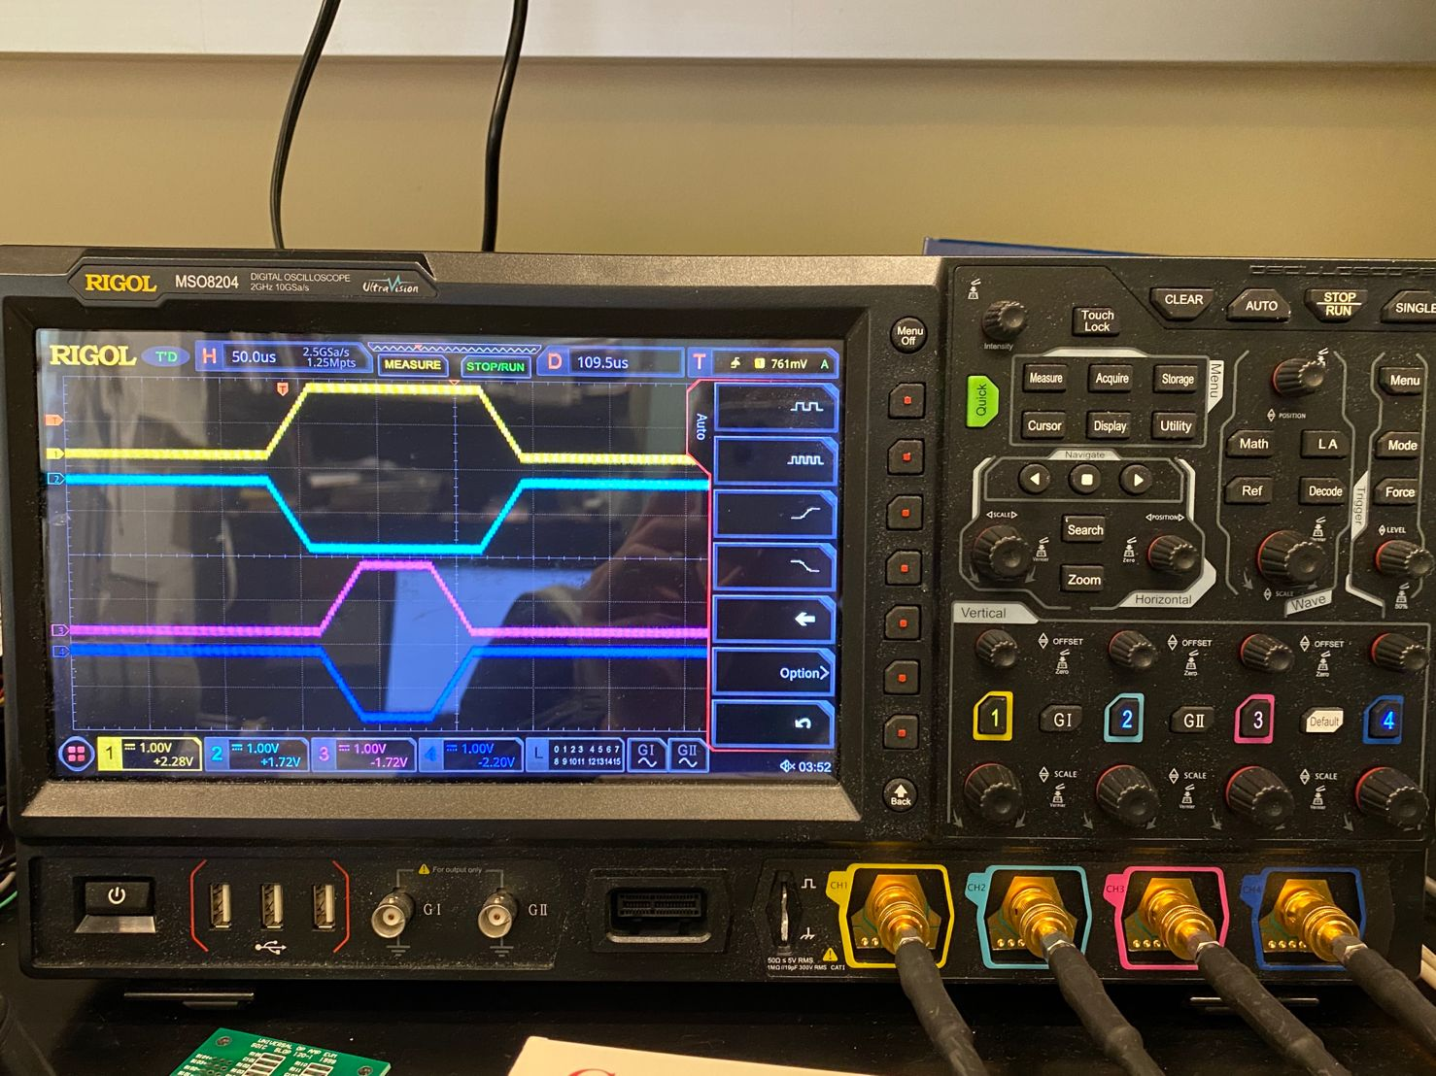
Fall 2021
Collaboration with Jack Bannon
ReadandCreateWave(1.2).py
LabOne Python API
Ran from the command line
Loaded file from the command line
Still hardcoded (except waveform file)
Could not specify frequency
Devices not synchronized (limited to 8 channels)

Slide 6
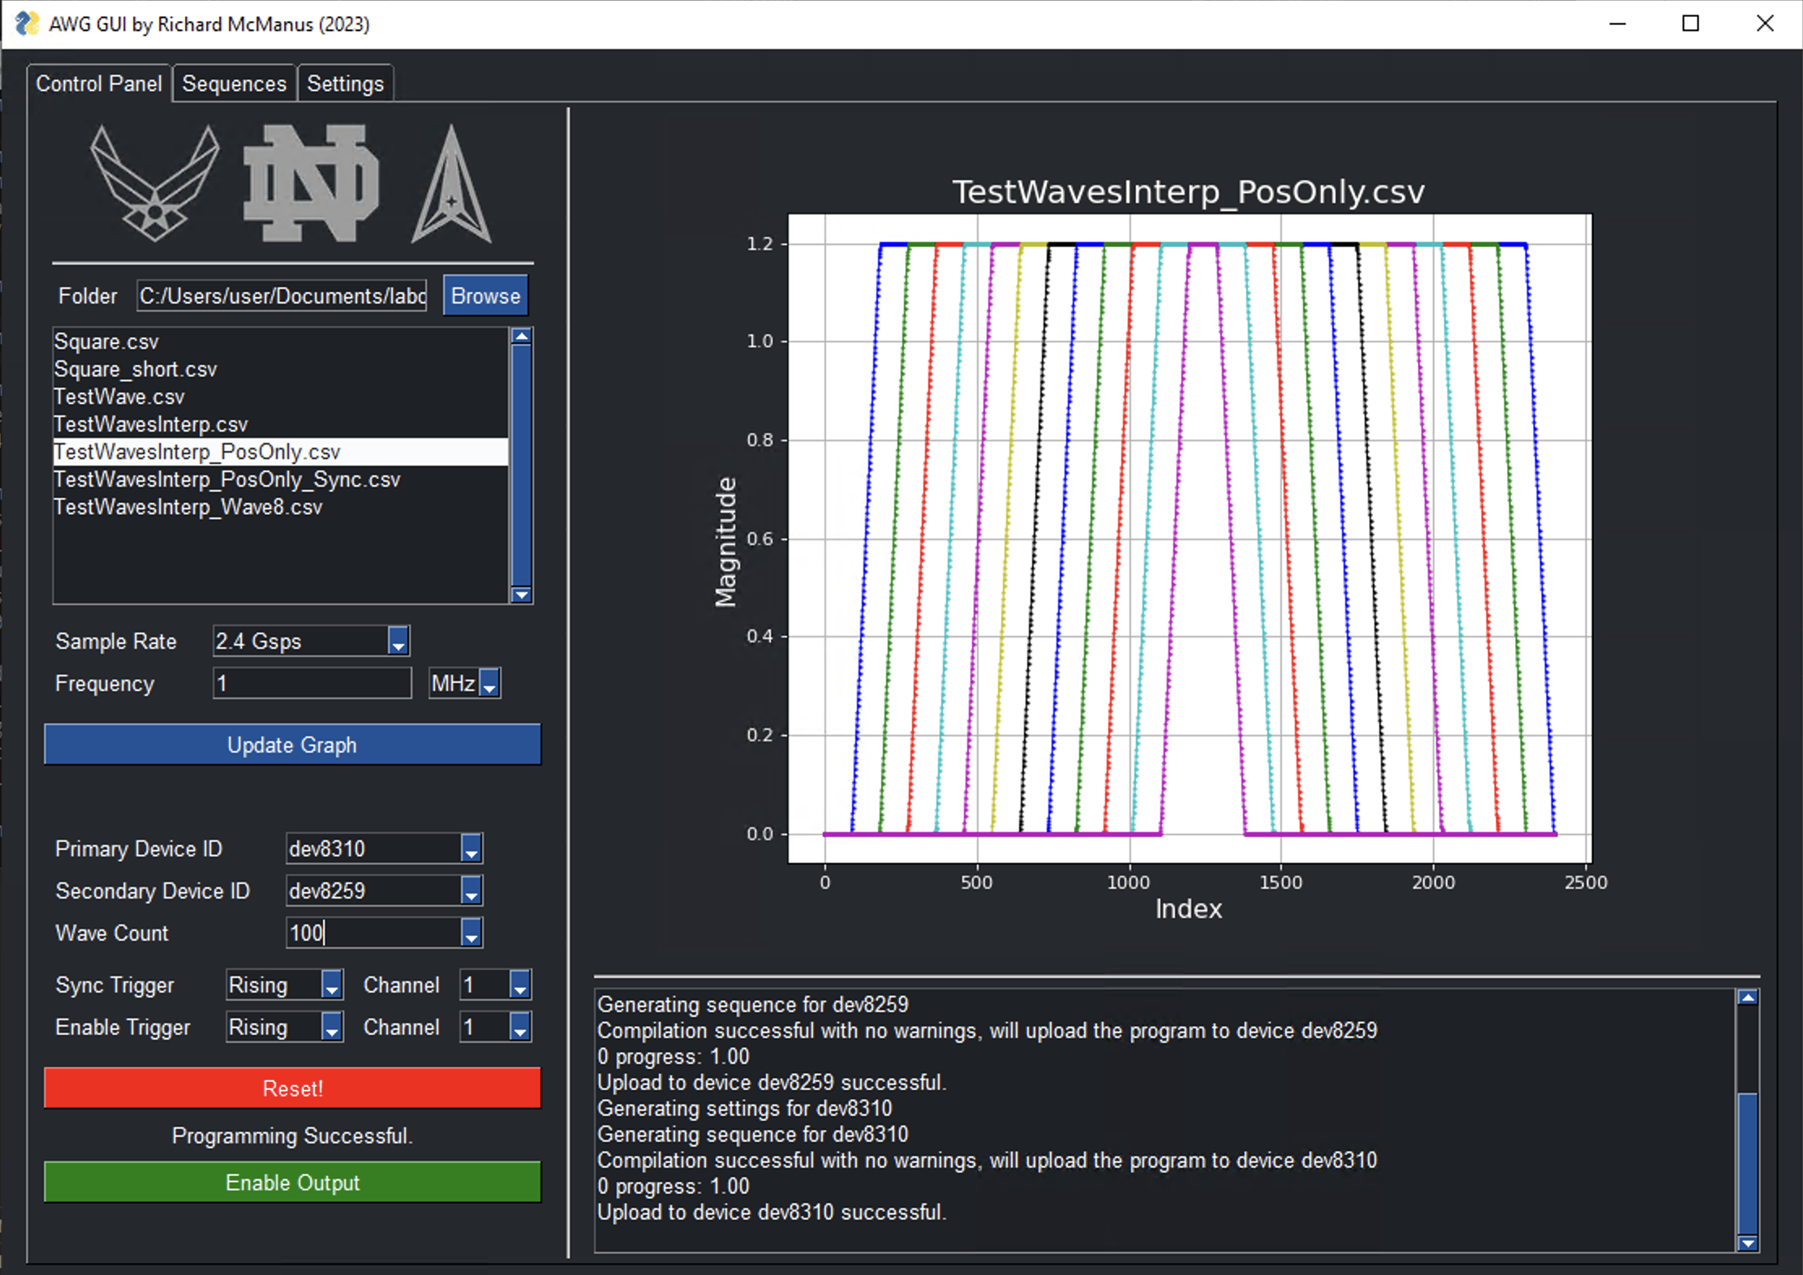
Spring 2023
AWG_GUI.py
(Overview)

Slide 7
Control Panel
Browse for waveform folder
Load waveforms from .csv file
Specify:
primary and secondary devices
sample rate and frequency of waveforms
duration of playback (wavelengths)
triggers
sync trigger between devices
enable trigger to initiate playback

Slide 8
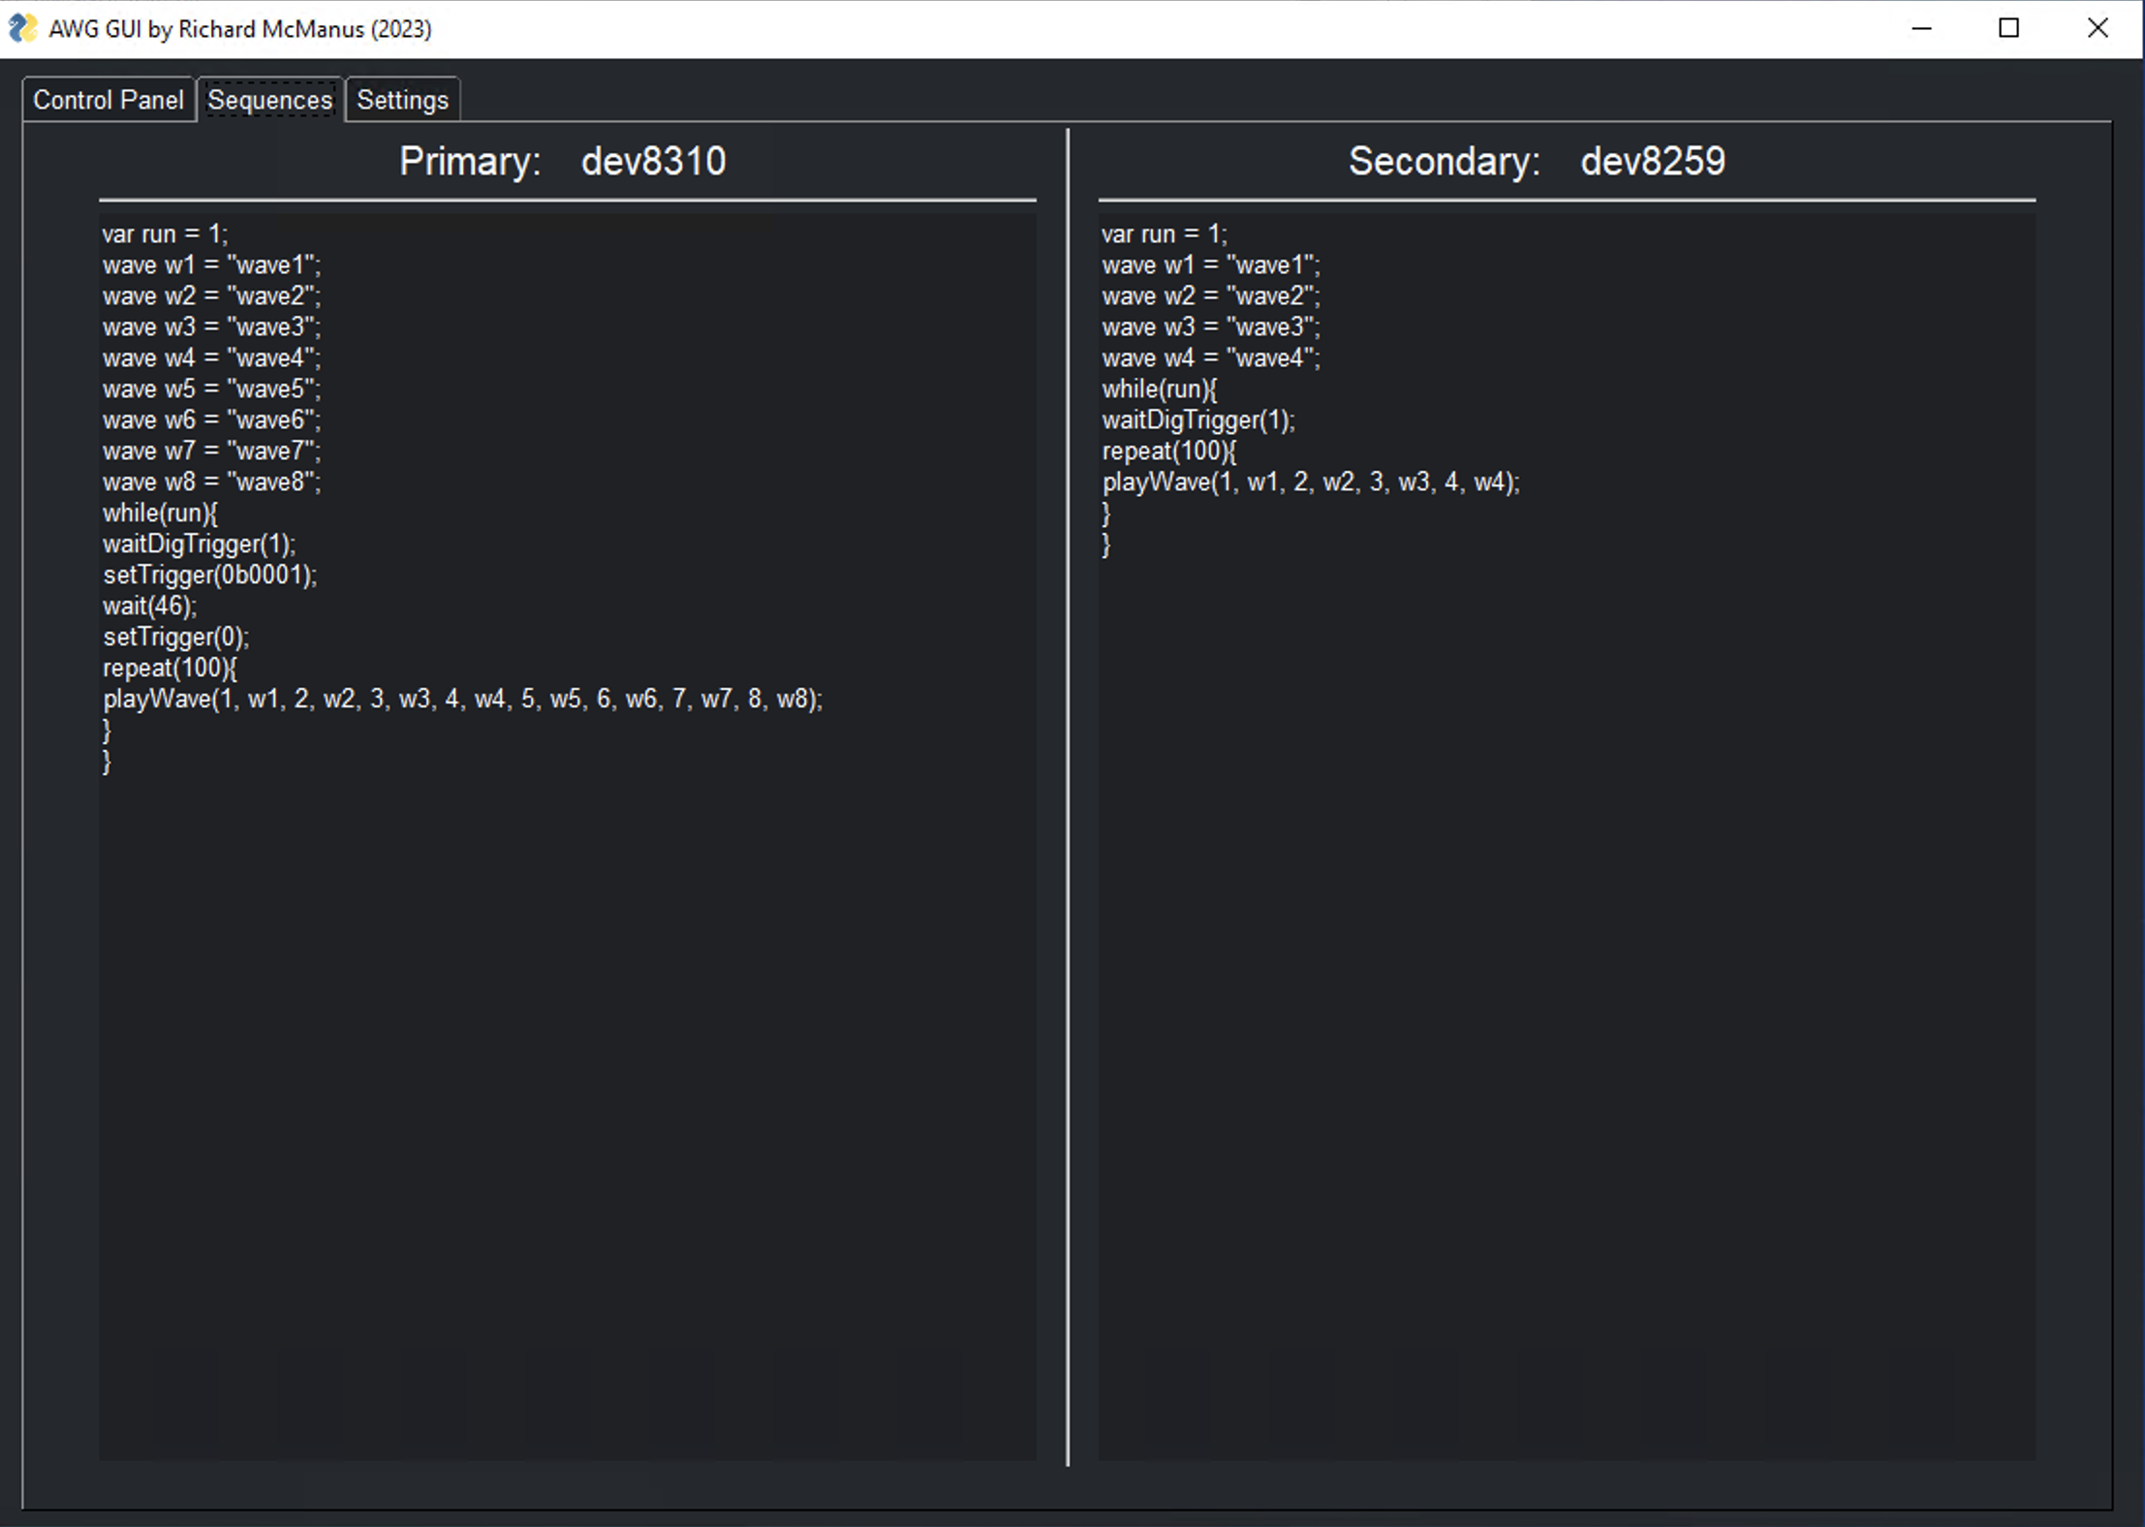
Sequences Tab
Displays primary and secondary sequences
Generated from control panel configuration
Uploaded to HDAWGs via Zurich’s Python LabOne API

Slide 9
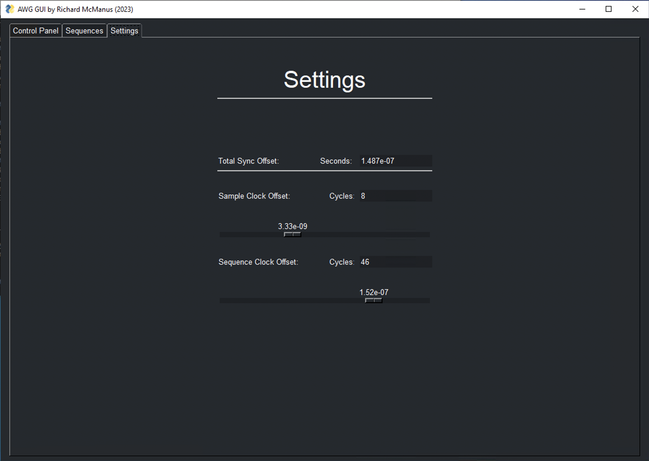
Settings Tab (Used to Sync Devices)
Sample Clock Offset (Fine)
rotates secondary device wave array
Sample Rate Dependent
Discrete values of 1/(sample rate)
0.4167 ns for 2.4 Gsps
Sequence Clock Offset (Coarse)
delays primary device sequence
Discrete values of 3.33 ns
Total = Sequence - Sample

Slide 10
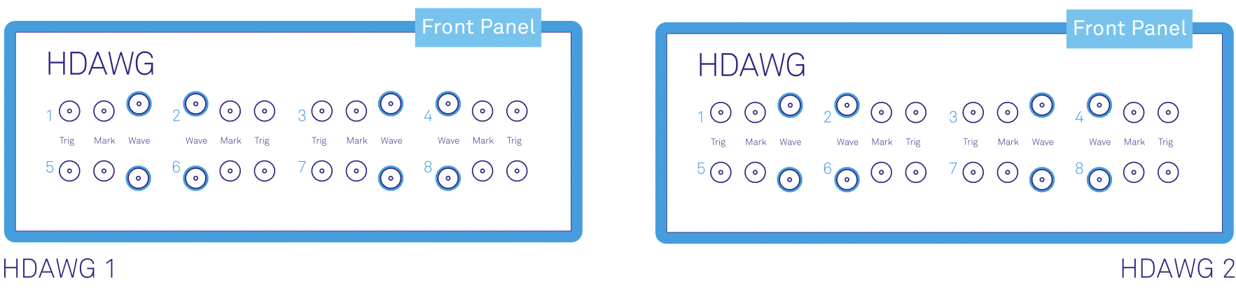
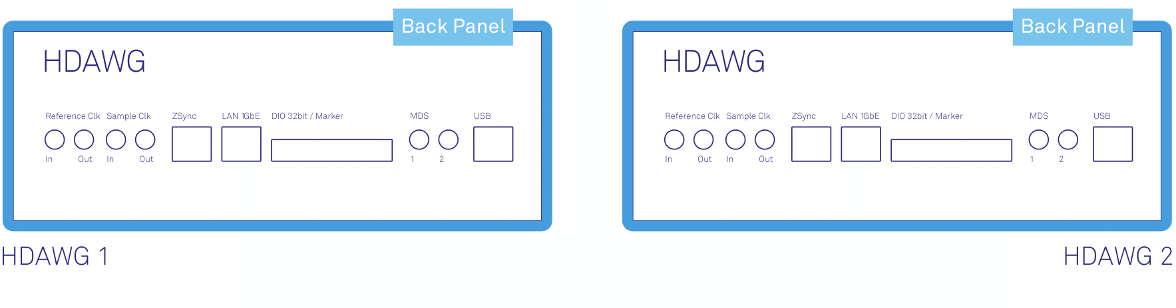
Common Configuration
Primary
Secondary
Front Panel
Sync Trigger
HDAWG 1, Mark 1 to HDAWG 2, Trig 1
Back Panel
Reference Clock
HDAWG 2, Reference Clk Out to HDAWG 1, Reference Clk In
Sync Trigger
Reference Clock

Slide 11
Under the hood

Slide 12
Specifying Frequency
def create_interp_array(filename, frequency, sampleRate):
# Function that loads a csv file and interpolates sample points to achieve desired frequency from specified sample rate
array = np.loadtxt(filename, delimiter=",") # Load csv file into array
numCols = len(array[0])
magnitude = [] # Initialize list for y coordinates
for i in range(numCols): # Interpolate each column/waveform
time = np.linspace(0, len(array[:,i]), int(sampleRate/frequency), endpoint = True)
magnitude.append(np.interp(time,np.linspace(0,len(array[:,i]),len(array[:,i]), endpoint = False),array[:,i]))
magnitude = np.transpose(magnitude)
return magnitude # Return interpolated 2D array

Slide 13
Syncing Devices – Reference Clock
Primary
Secondary
Reference Clock
PC
runtime = 0
Programming disrupts reference clock
Uses internal clock of secondary device
Programmed First
program
Secondary
program
wait for trigger
Primary
runtime

Slide 14
Syncing Devices – Offsets
Primary
Secondary
No Offset
Sequence Clock Offset
Sample Clock Offset

Slide 15
Comparison of Zurich Hdawg Synchronization Methods

Slide 16
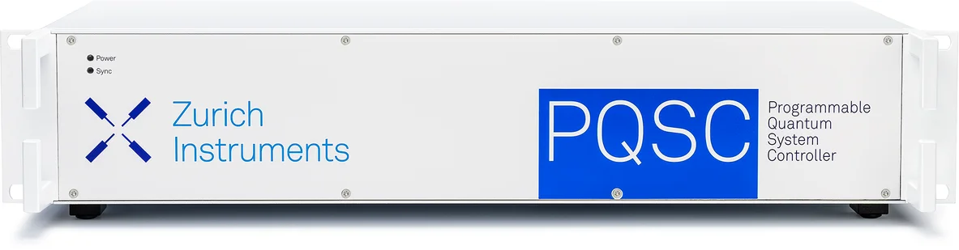
Method 1: Zurich PQSC

Slide 17
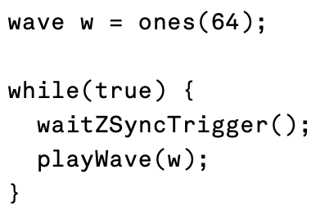
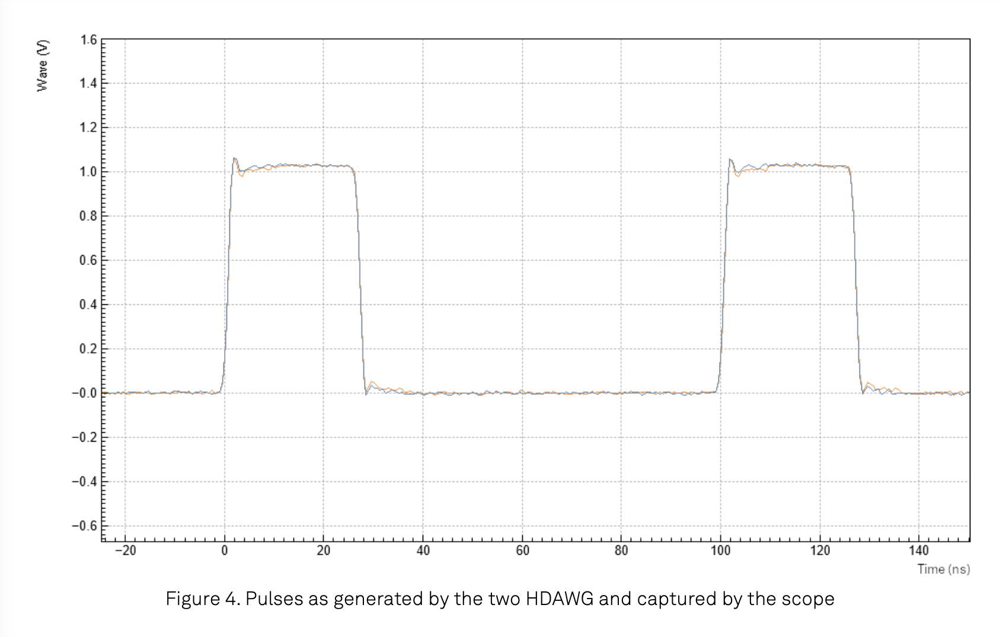
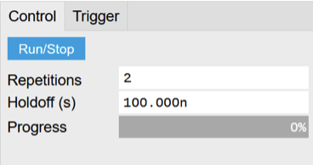
Zurich Example PQSC Synchronization (Synchronization of multiple HDAWGs)
AWG Sequencer
PQSC Output

Slide 18
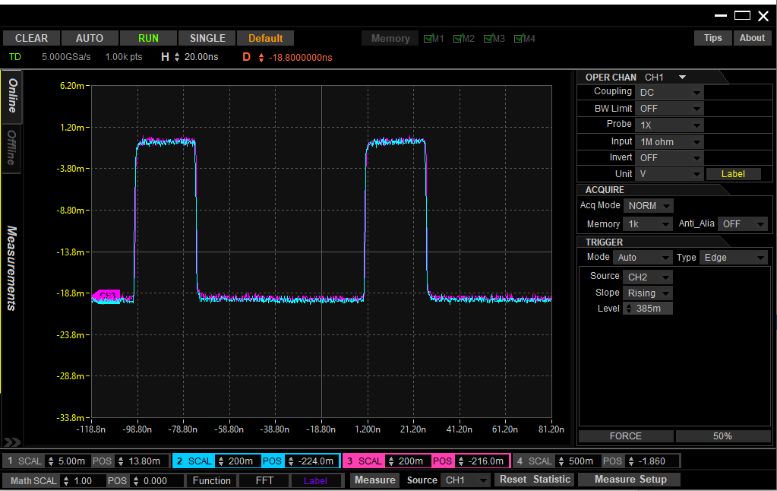
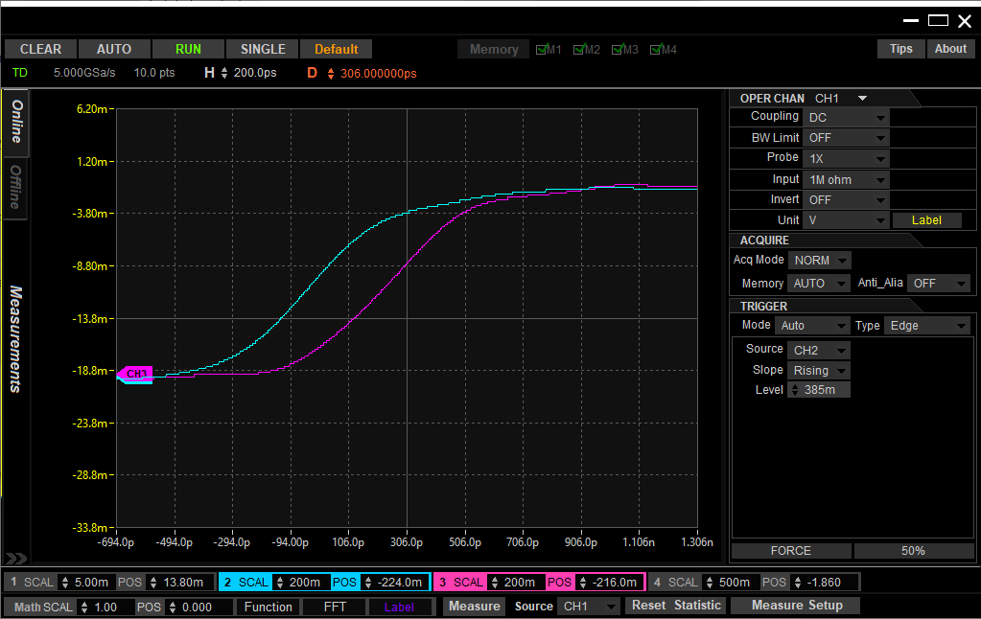
Zurich Example PQSC Synchronization Recreated
20ns per division
200ps per division
Delay of ~250ps

Slide 19
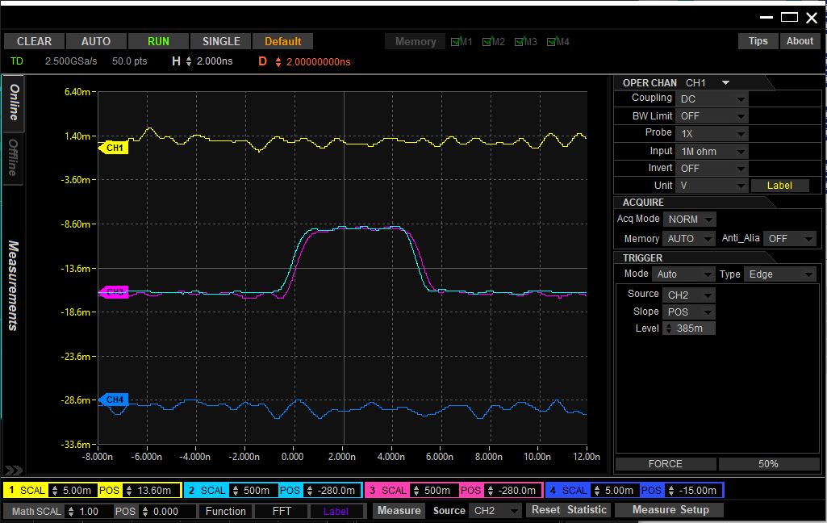
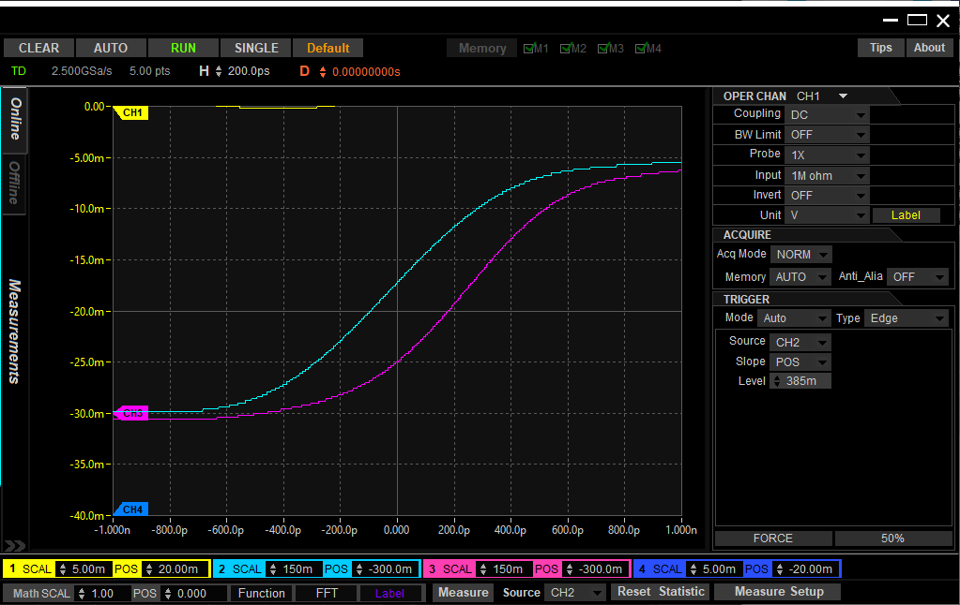
Zurich PQSC Ramp Wave Test (75 Mhz), Wave 8 of 12, Two HDawgs
2ns per division
200ps per division
Delay of ~250ps

Slide 20
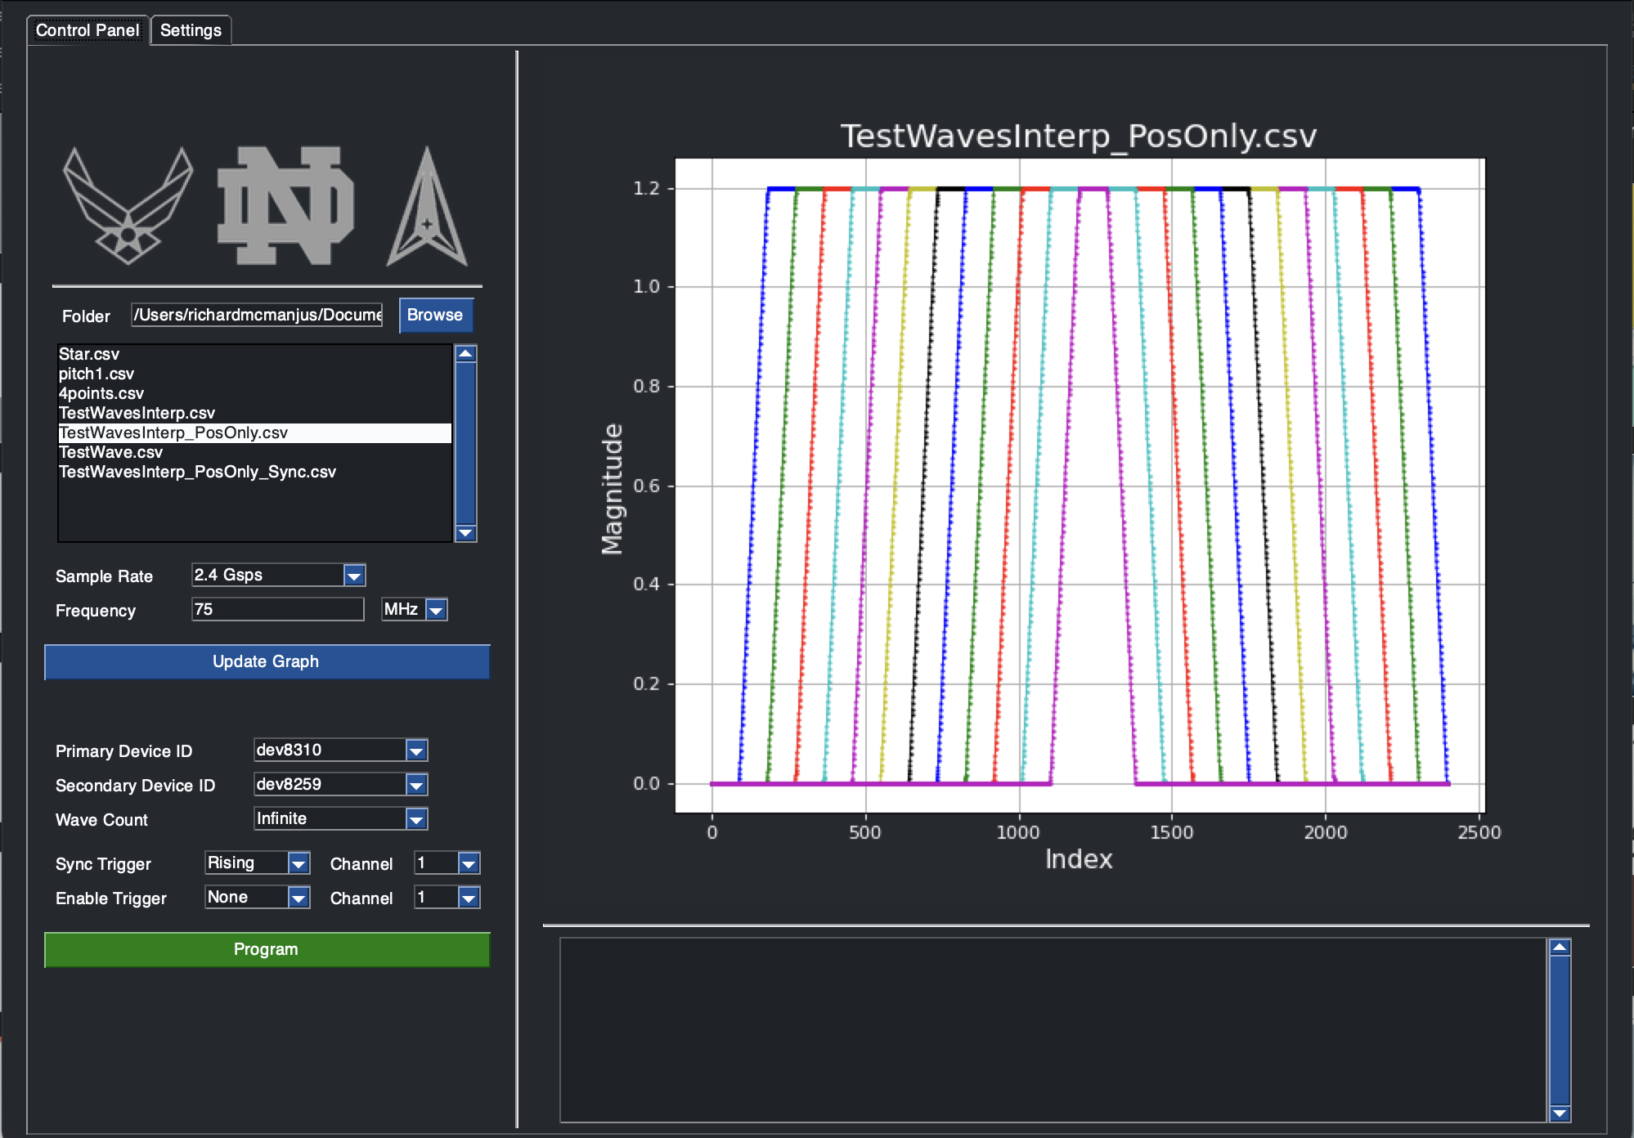
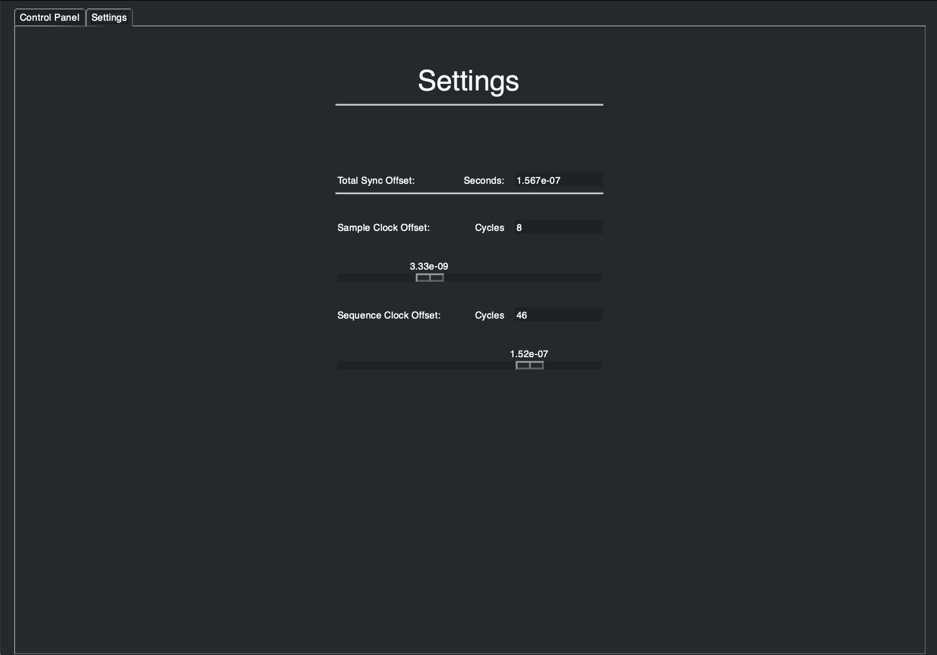
Method 2: Delay Compensation (AWG_GUI.py)

Slide 21
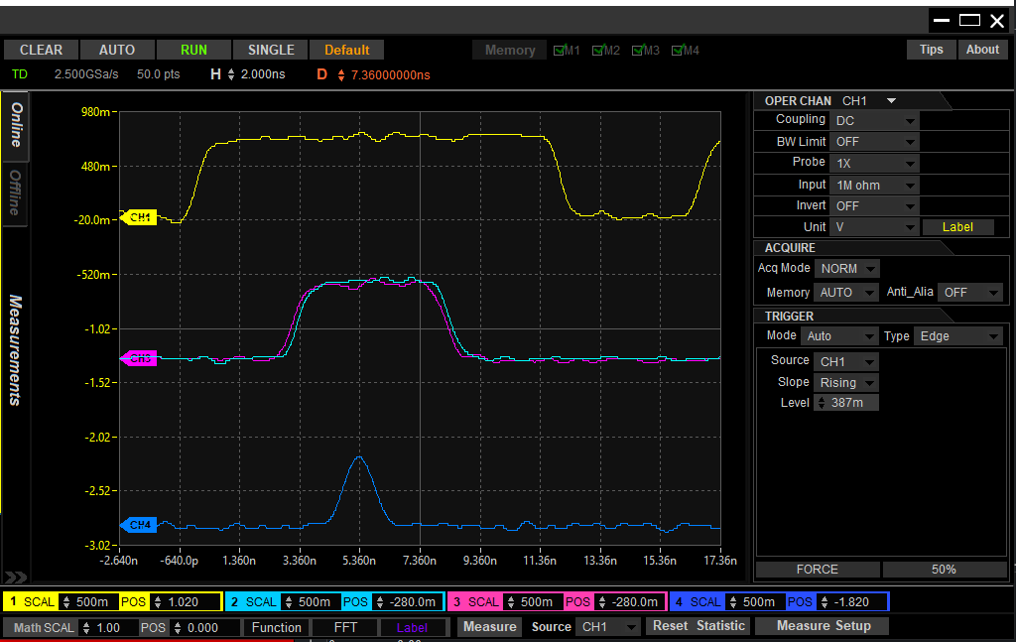
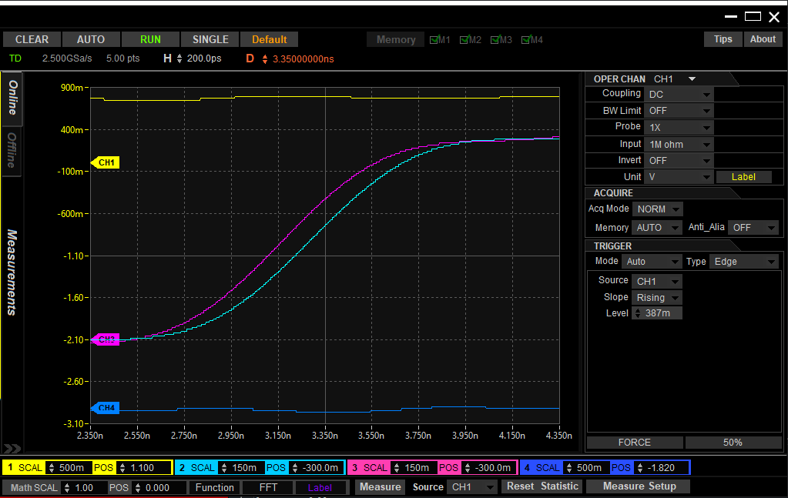
Delay Compensation Ramp Wave test (75 Mhz), Wave 8 of 12, TWO HDAWGS
2ns per division
200ps per division
Delay of ~150ps

Slide 22
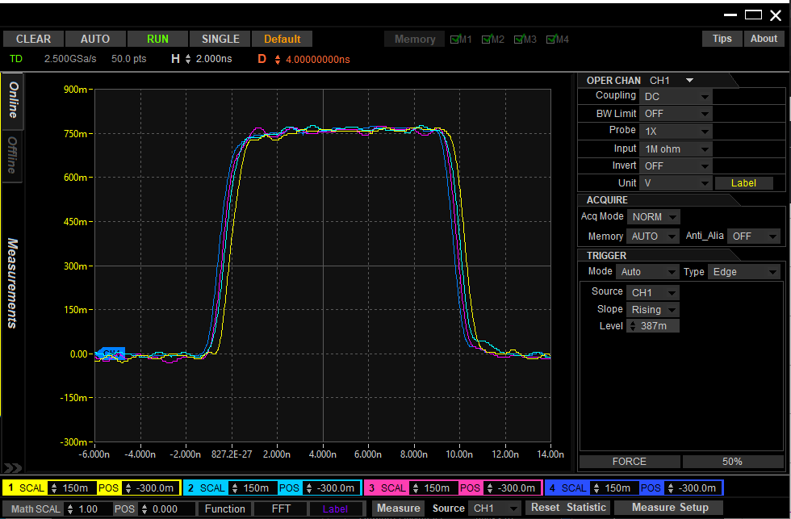
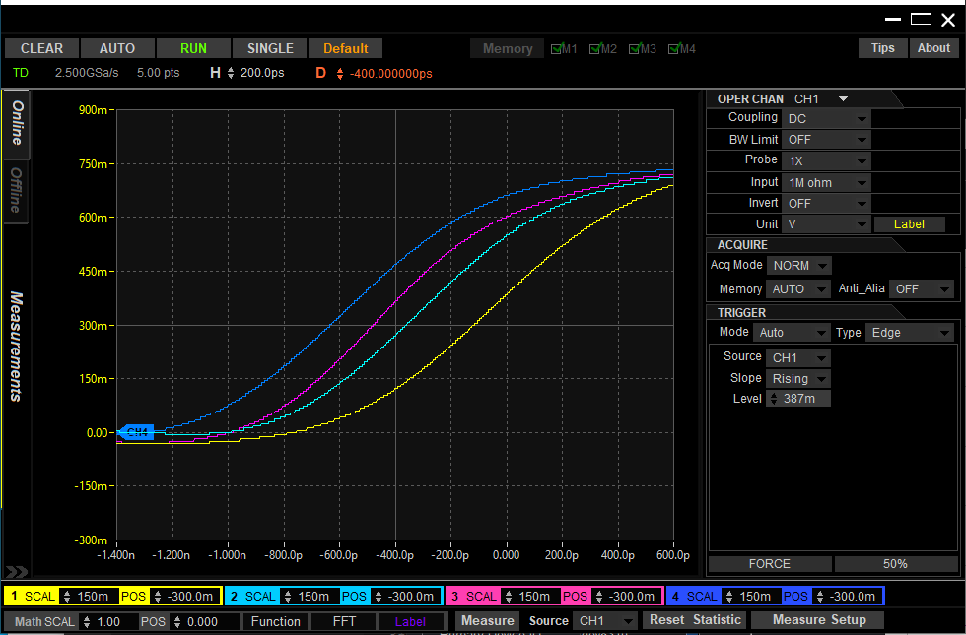
Delay Compensation Ramp Wave test (37.5 Mhz), Wave 8 of 12, TWO HDAWGS
Scope Ch. | HDAWG # | HDAWG CH.
1 | 1 | 1
2 | 1 | 2
3 | 2 | 1
4 | 2 | 2
2ns per division
Delay between HDAWGs (Scope Ch. 2 and Ch. 3): 100ps – 150ps
Delay between channels of HDAWG #1 (Scope Ch. 1 and Ch. 2): 200ps – 250ps
Delay between channels of HDAWG #2 (Scope Ch. 3 and Ch. 4): 150ps – 200ps
200ps per division

Slide 23
Comparison of Methods
Method 1: Zurich PQSC
Delay of ~250ps
Equal to or greater than the delay between subsequent channels of the same HDAWG
Method 2: Delay Compensation
Delay of ~150ps
Equal to or less than the delay between subsequent channels of the same HDAWG

Slide 24
PCB Layout with Eagle

Slide 25
Background
AWG
AWG Trigger 1 Bit
12 Positive Ramps
Clocking Board
24 +/- Ramps
FPGA program bit-stream download (JTAG)
-IO 16 Bit (In/Out)
-Mem/Write (Out)
-PC Out 16 Bit
-Reset 1 Bit In
0 - 1.8v <-> +/-0.7V
0-1.8v <-> 0 – 1.2 V
PC
FPGA
Level Shifting
MIPS
FPGA upload program results after program is completed (JTAG)
Power Supply
Power Supply

Slide 26
Board #1 F2Ce

Slide 27
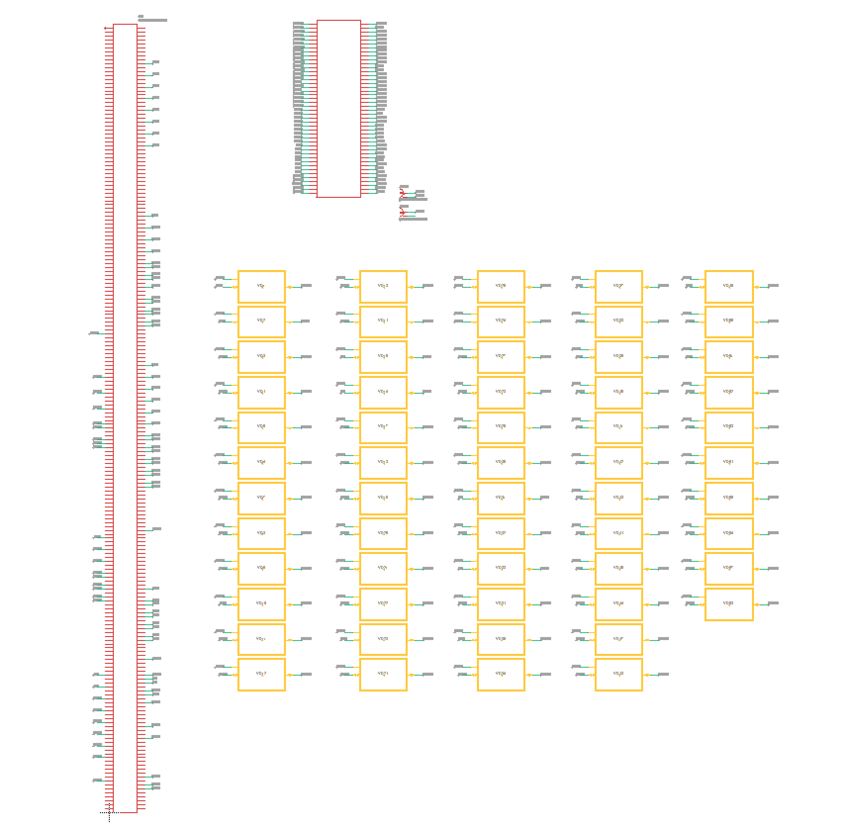
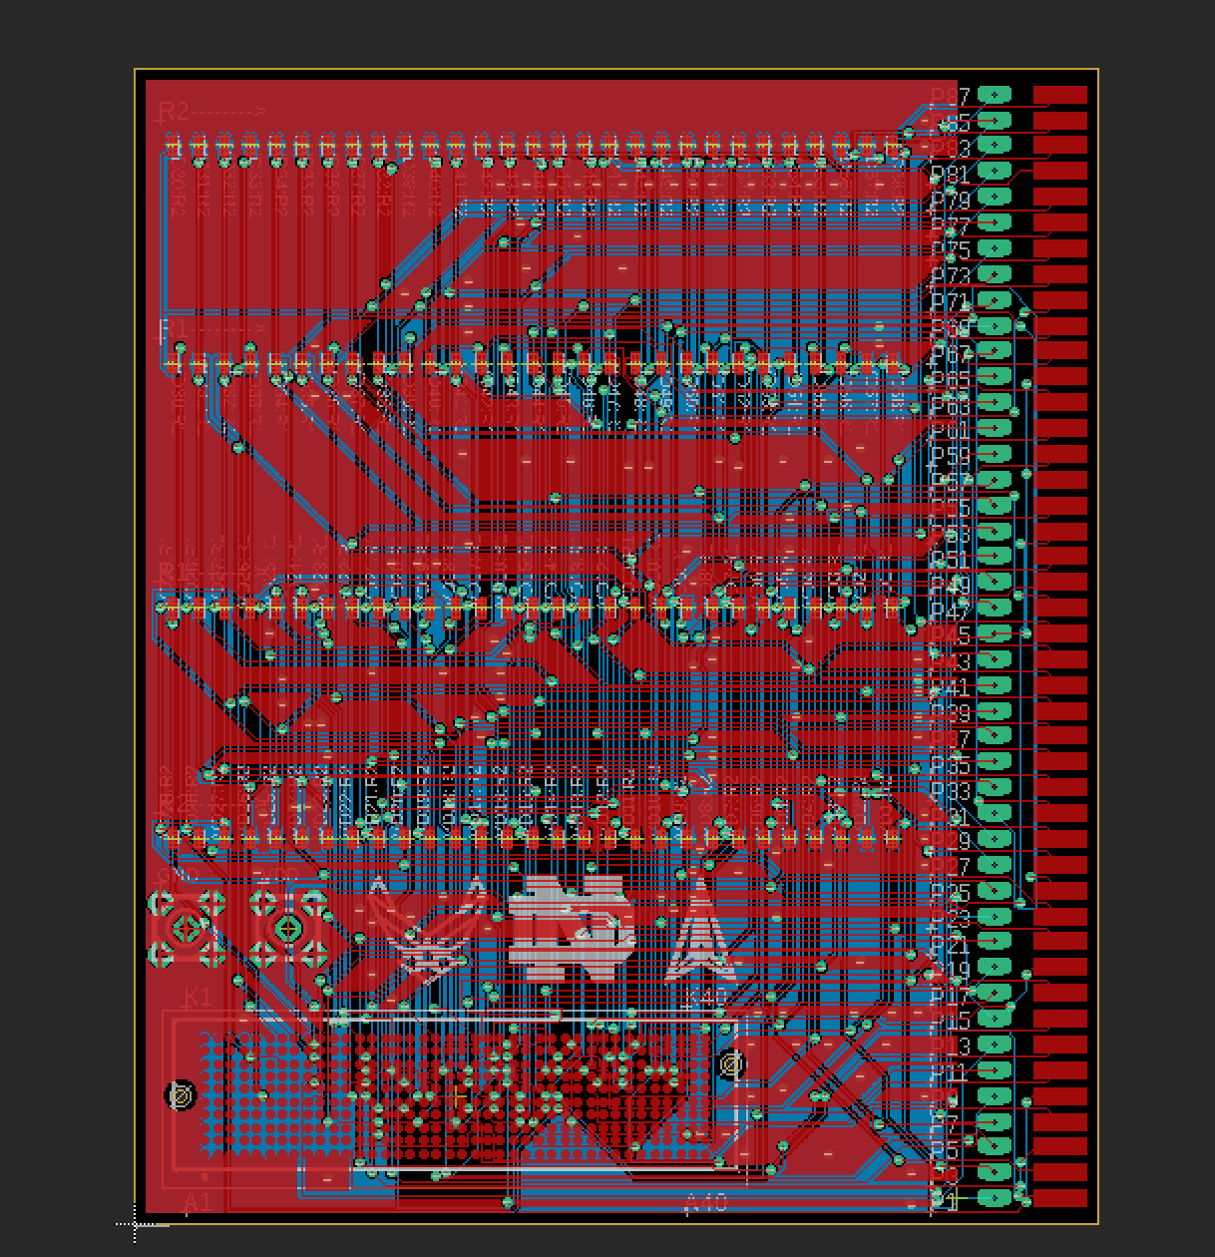
Fall 2022
F2CE_V2
58 voltage divider modules for level shifting in and in/out signals
26 out signals do not require level shifting

Slide 28
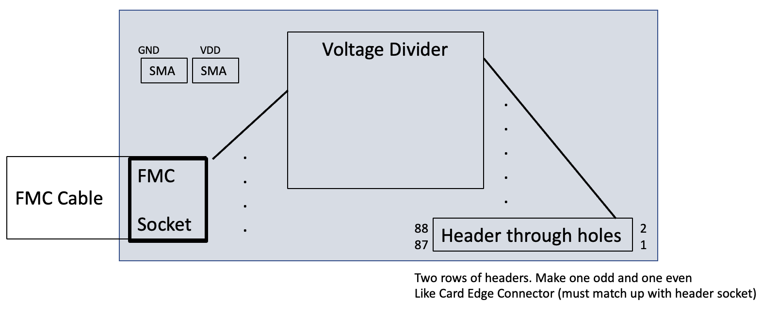
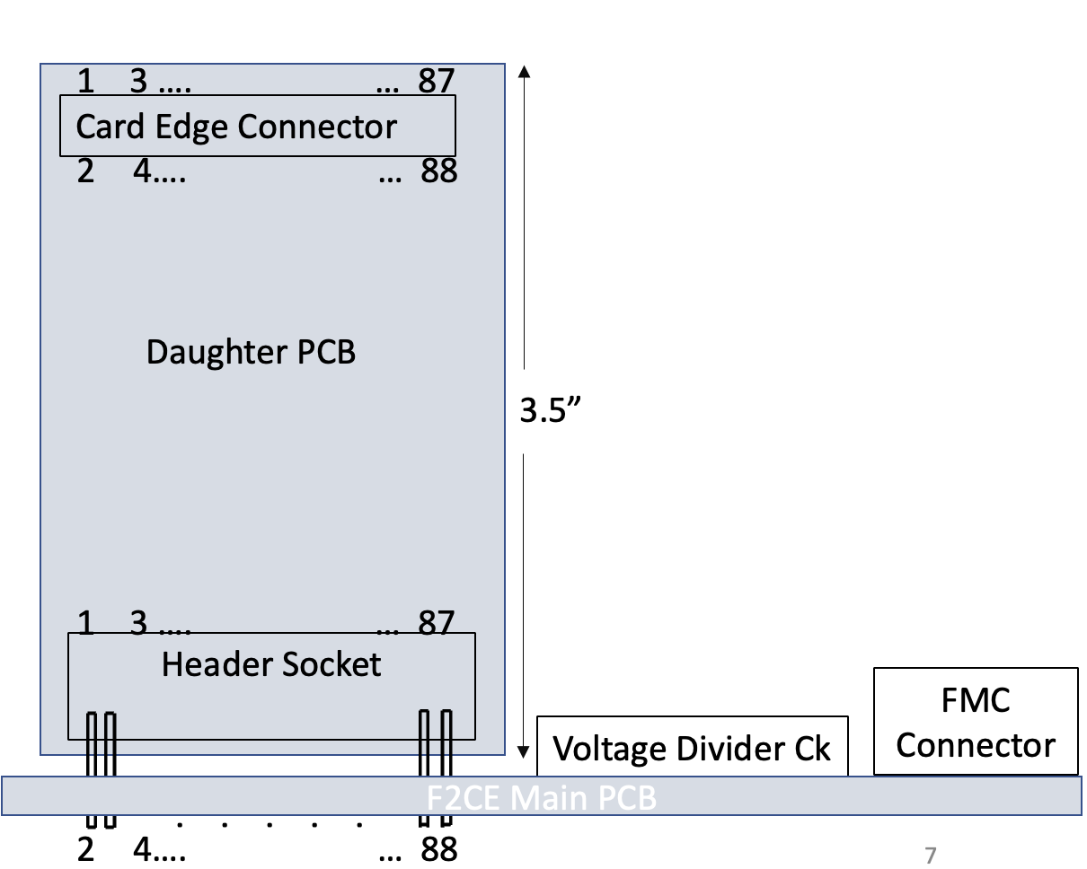
Spring 2023
Design changed to incorporate a main board and daughter board
88 Pin Header Interface

Slide 29
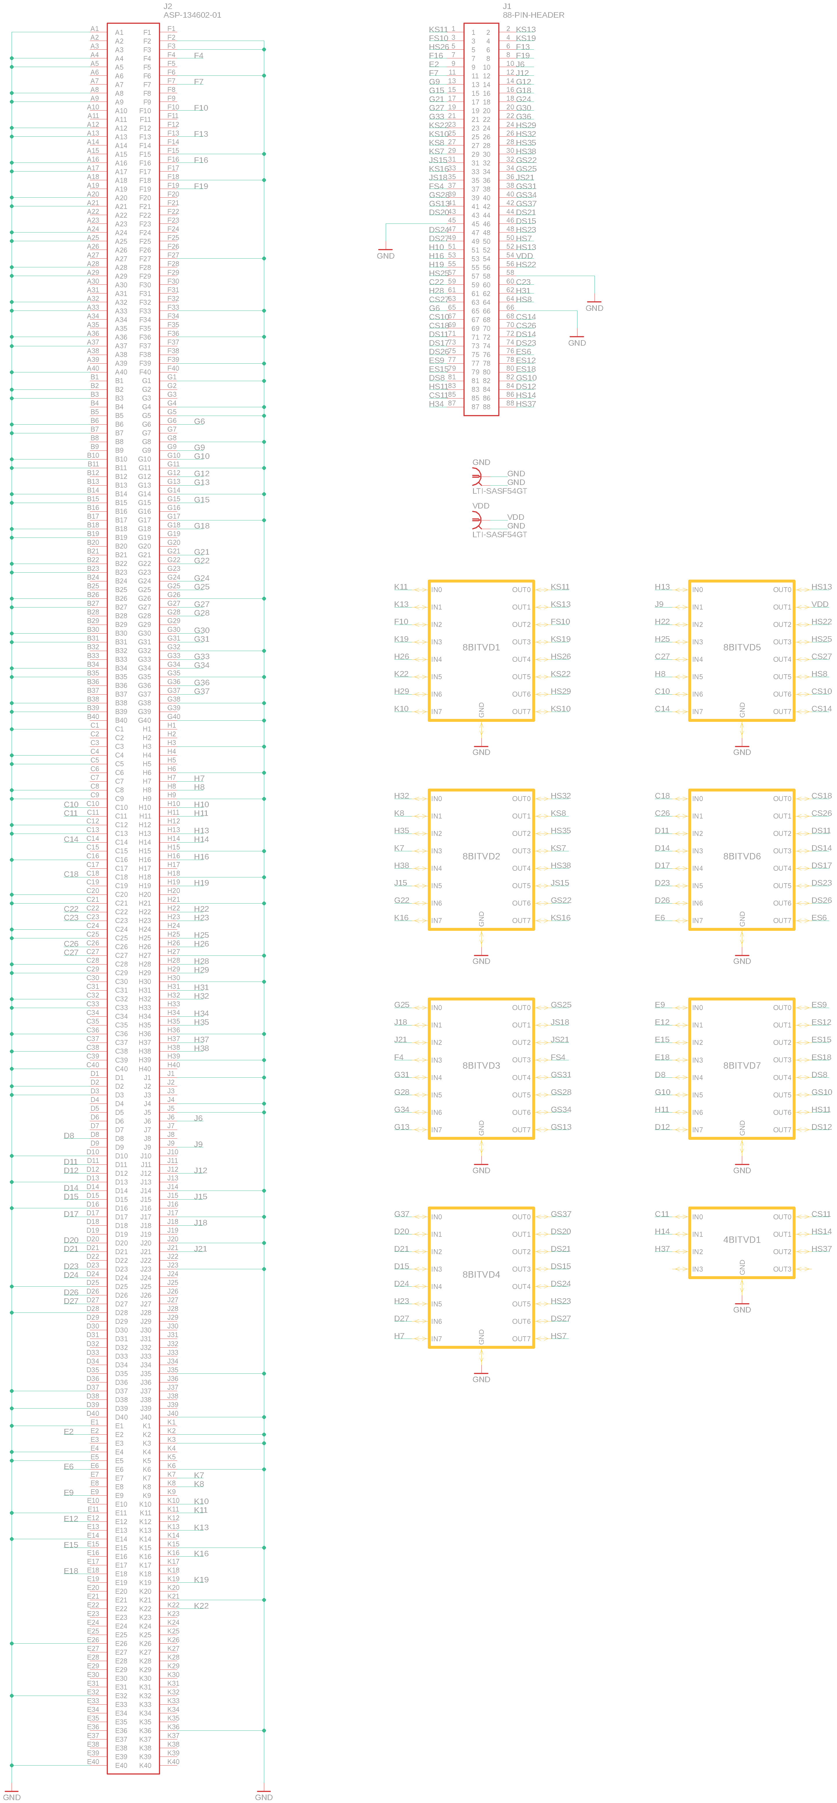
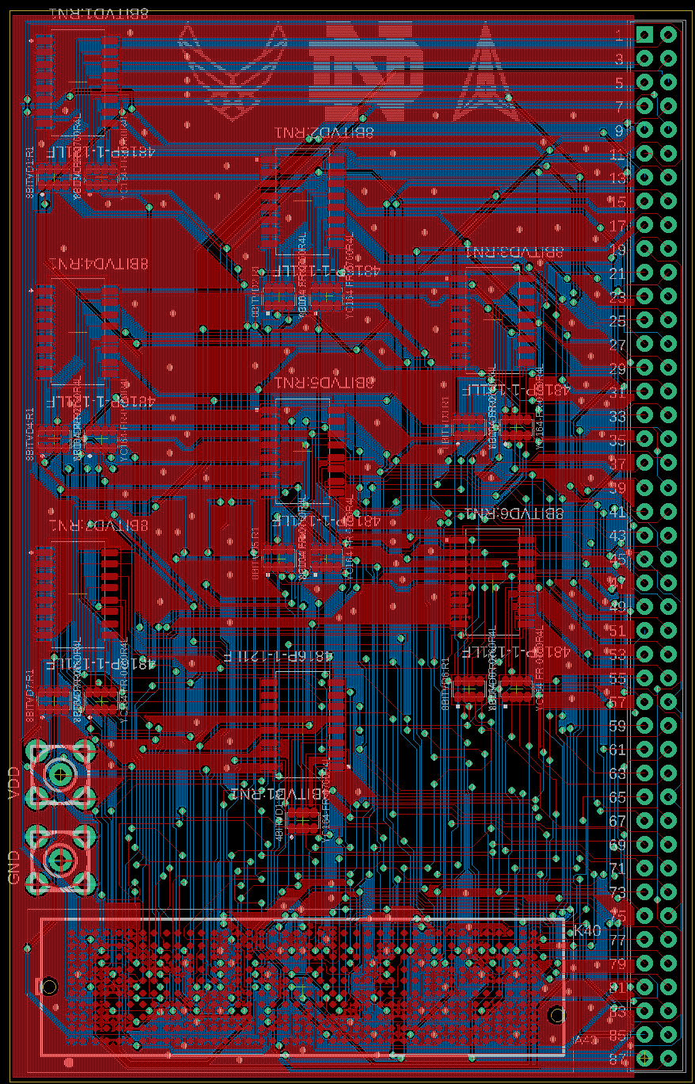
F2CE_V3.0
Utilized resistor arrays
60 ohm 4 resistors array
120 ohm 8 resistors array

Slide 30
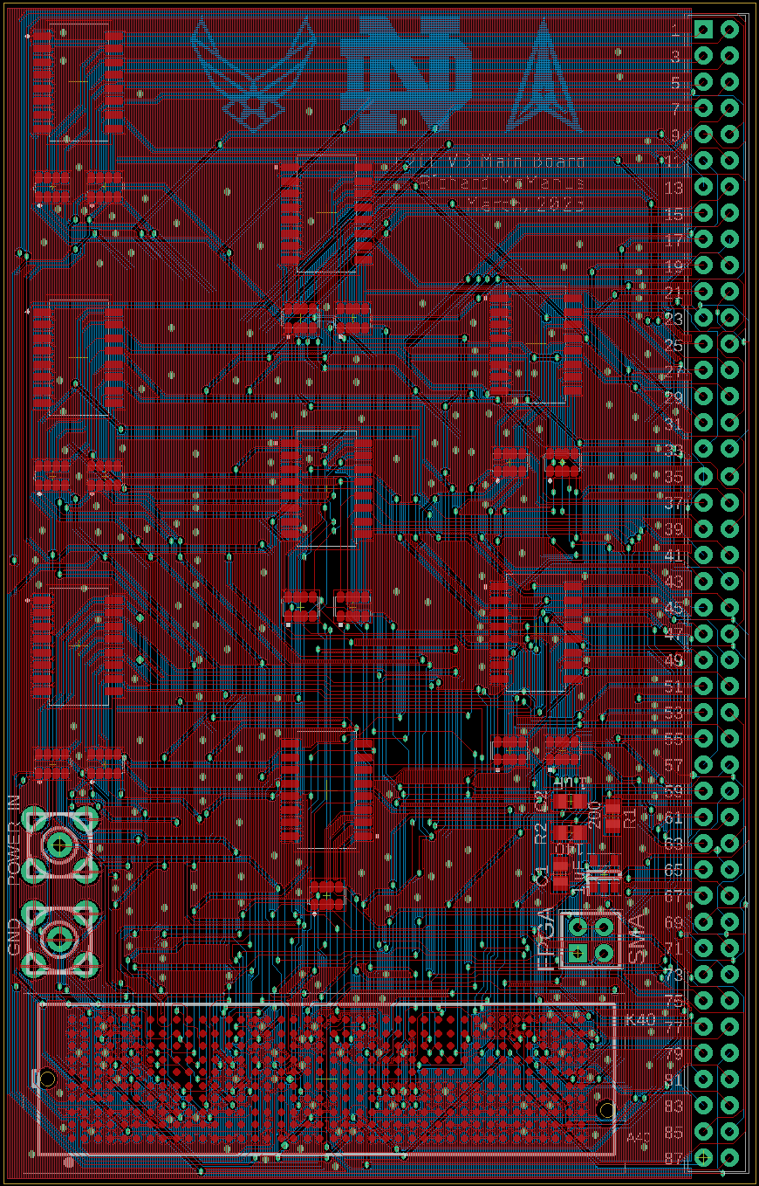
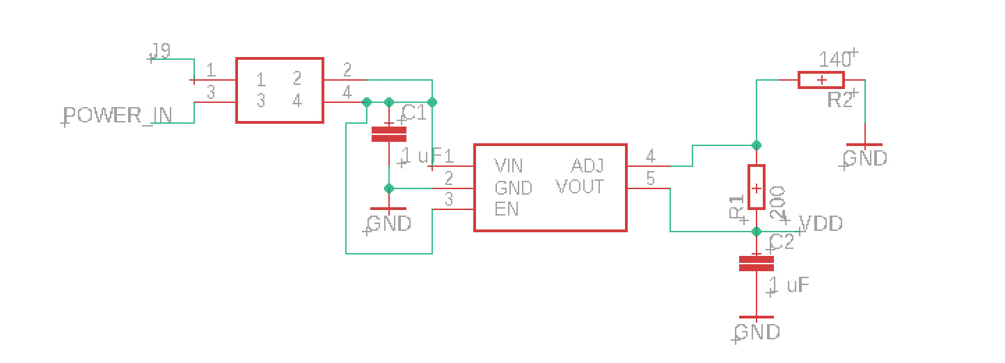
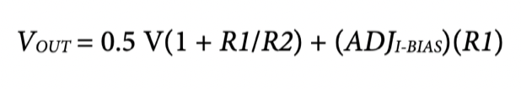
F2CE_V3.1
Implemented Power Regulator
ADP171
Set resistor values to provide 1.2 V
R1 = 510 ohm
R2 = 360 ohm
Board was ordered from Elecrow

Slide 31
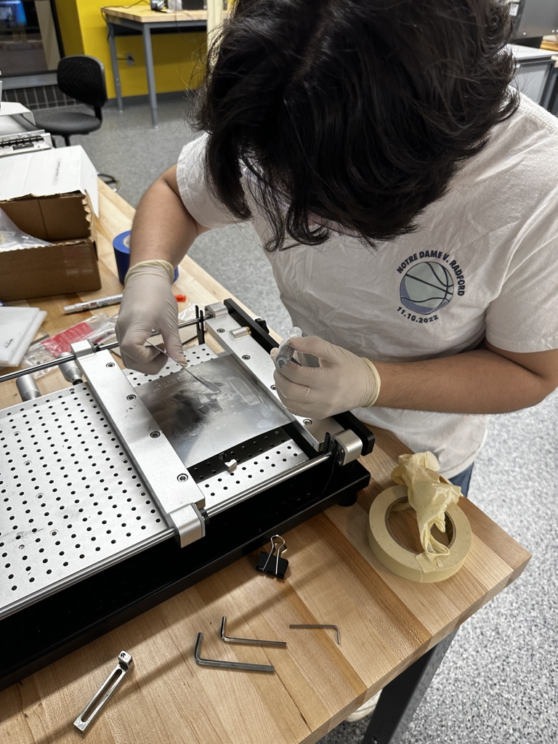
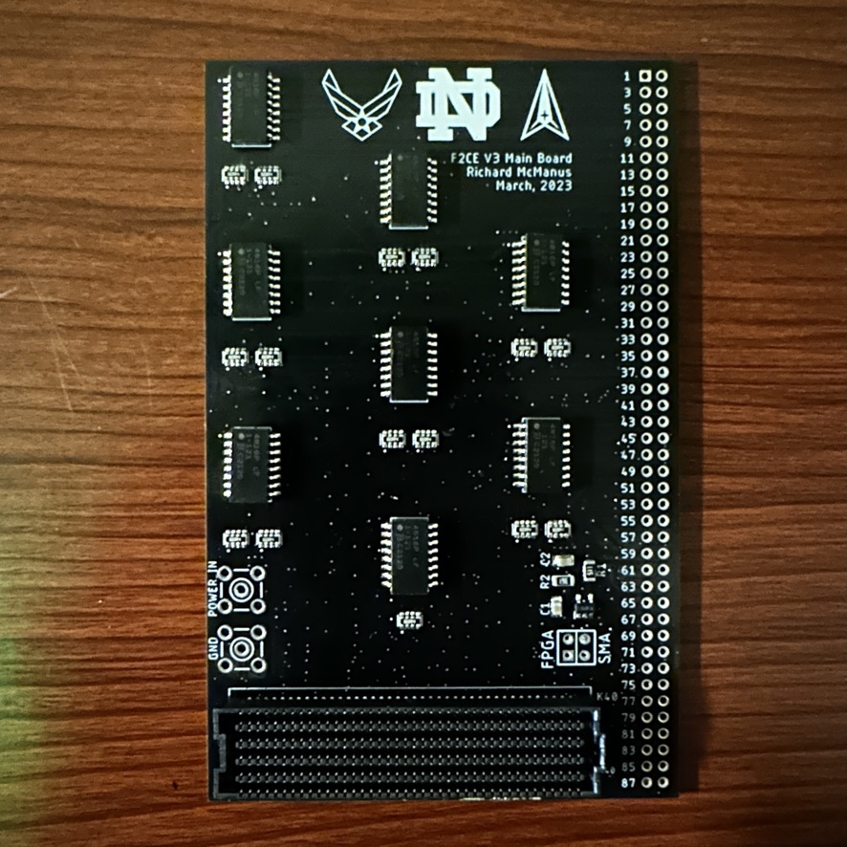
F2CE_V3.1 Assembly
Assembled with Ricky

Slide 32
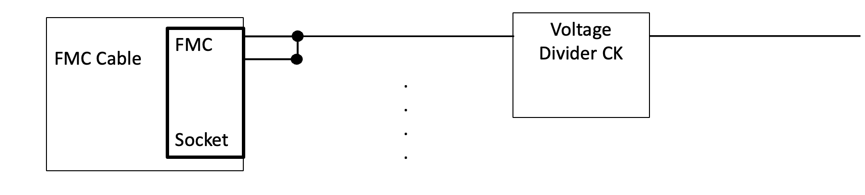
F2CE_V4
Discovered bi-directional IO requires input and output pins

Slide 33
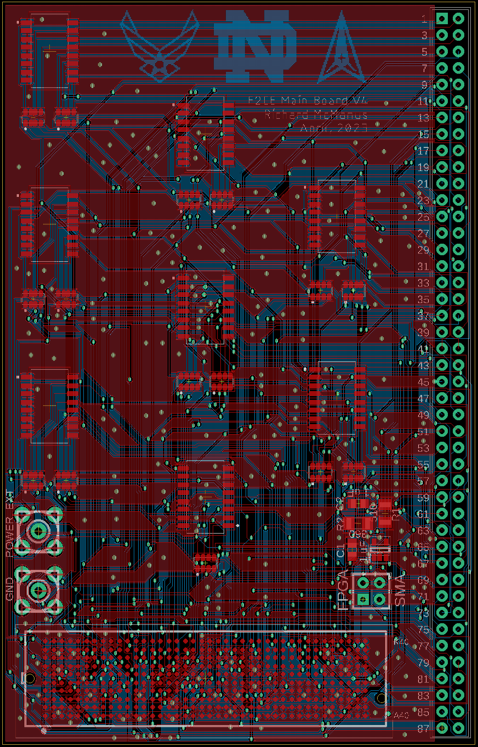
F2CE_V4.0
Implemented bi-directional redesign
15 additional traces routed
Board was ordered from Elecrow

Slide 34
Board #2 F2CE Daughter Board

Slide 35
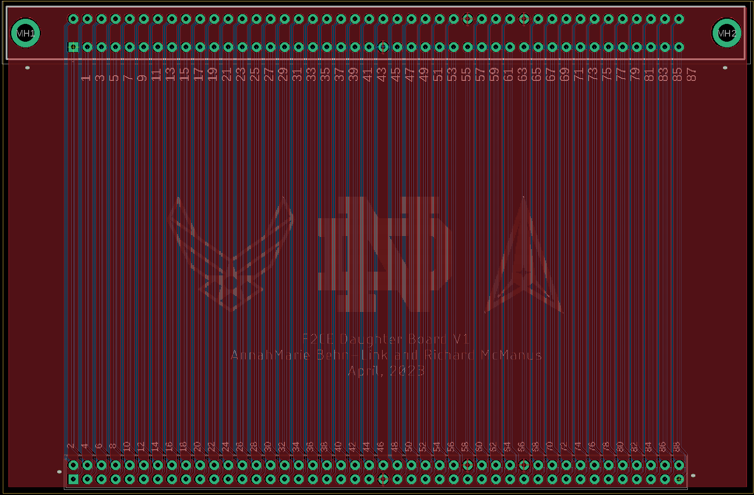
F2CE_Daughter
AnnahMarie laid out board
Compressed board
Centered Connectors
Ordered board from Elecrow

Slide 36
Board #3 Active Level Shifting Board

Slide 37
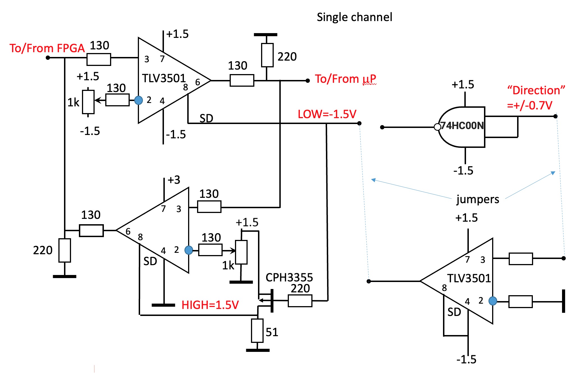
Circuit (Designed by Dr. Orlov)
Active Level Shifting
FPGA: 0 – 1.8V
MIPS: +/- 0.7 V
Utilizes 2 Comparators per bit
Direction-Controlling MOSFET

Slide 38
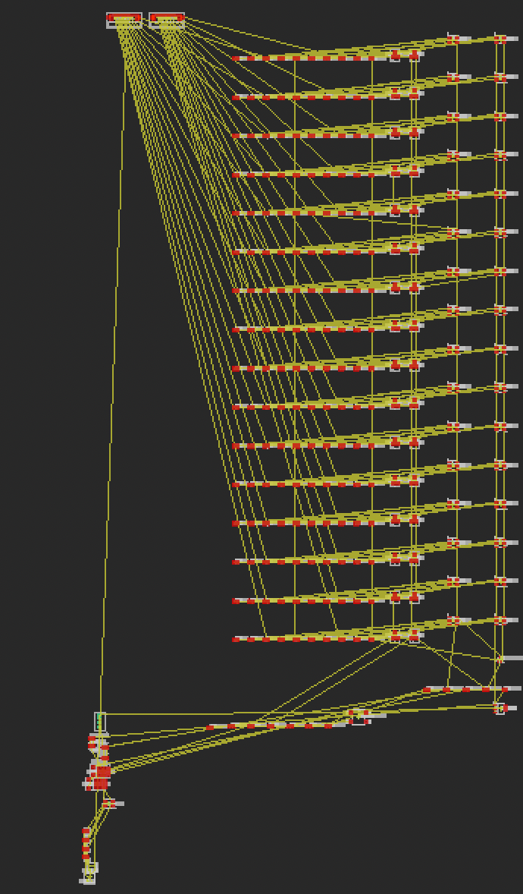
First Attempt

Slide 39
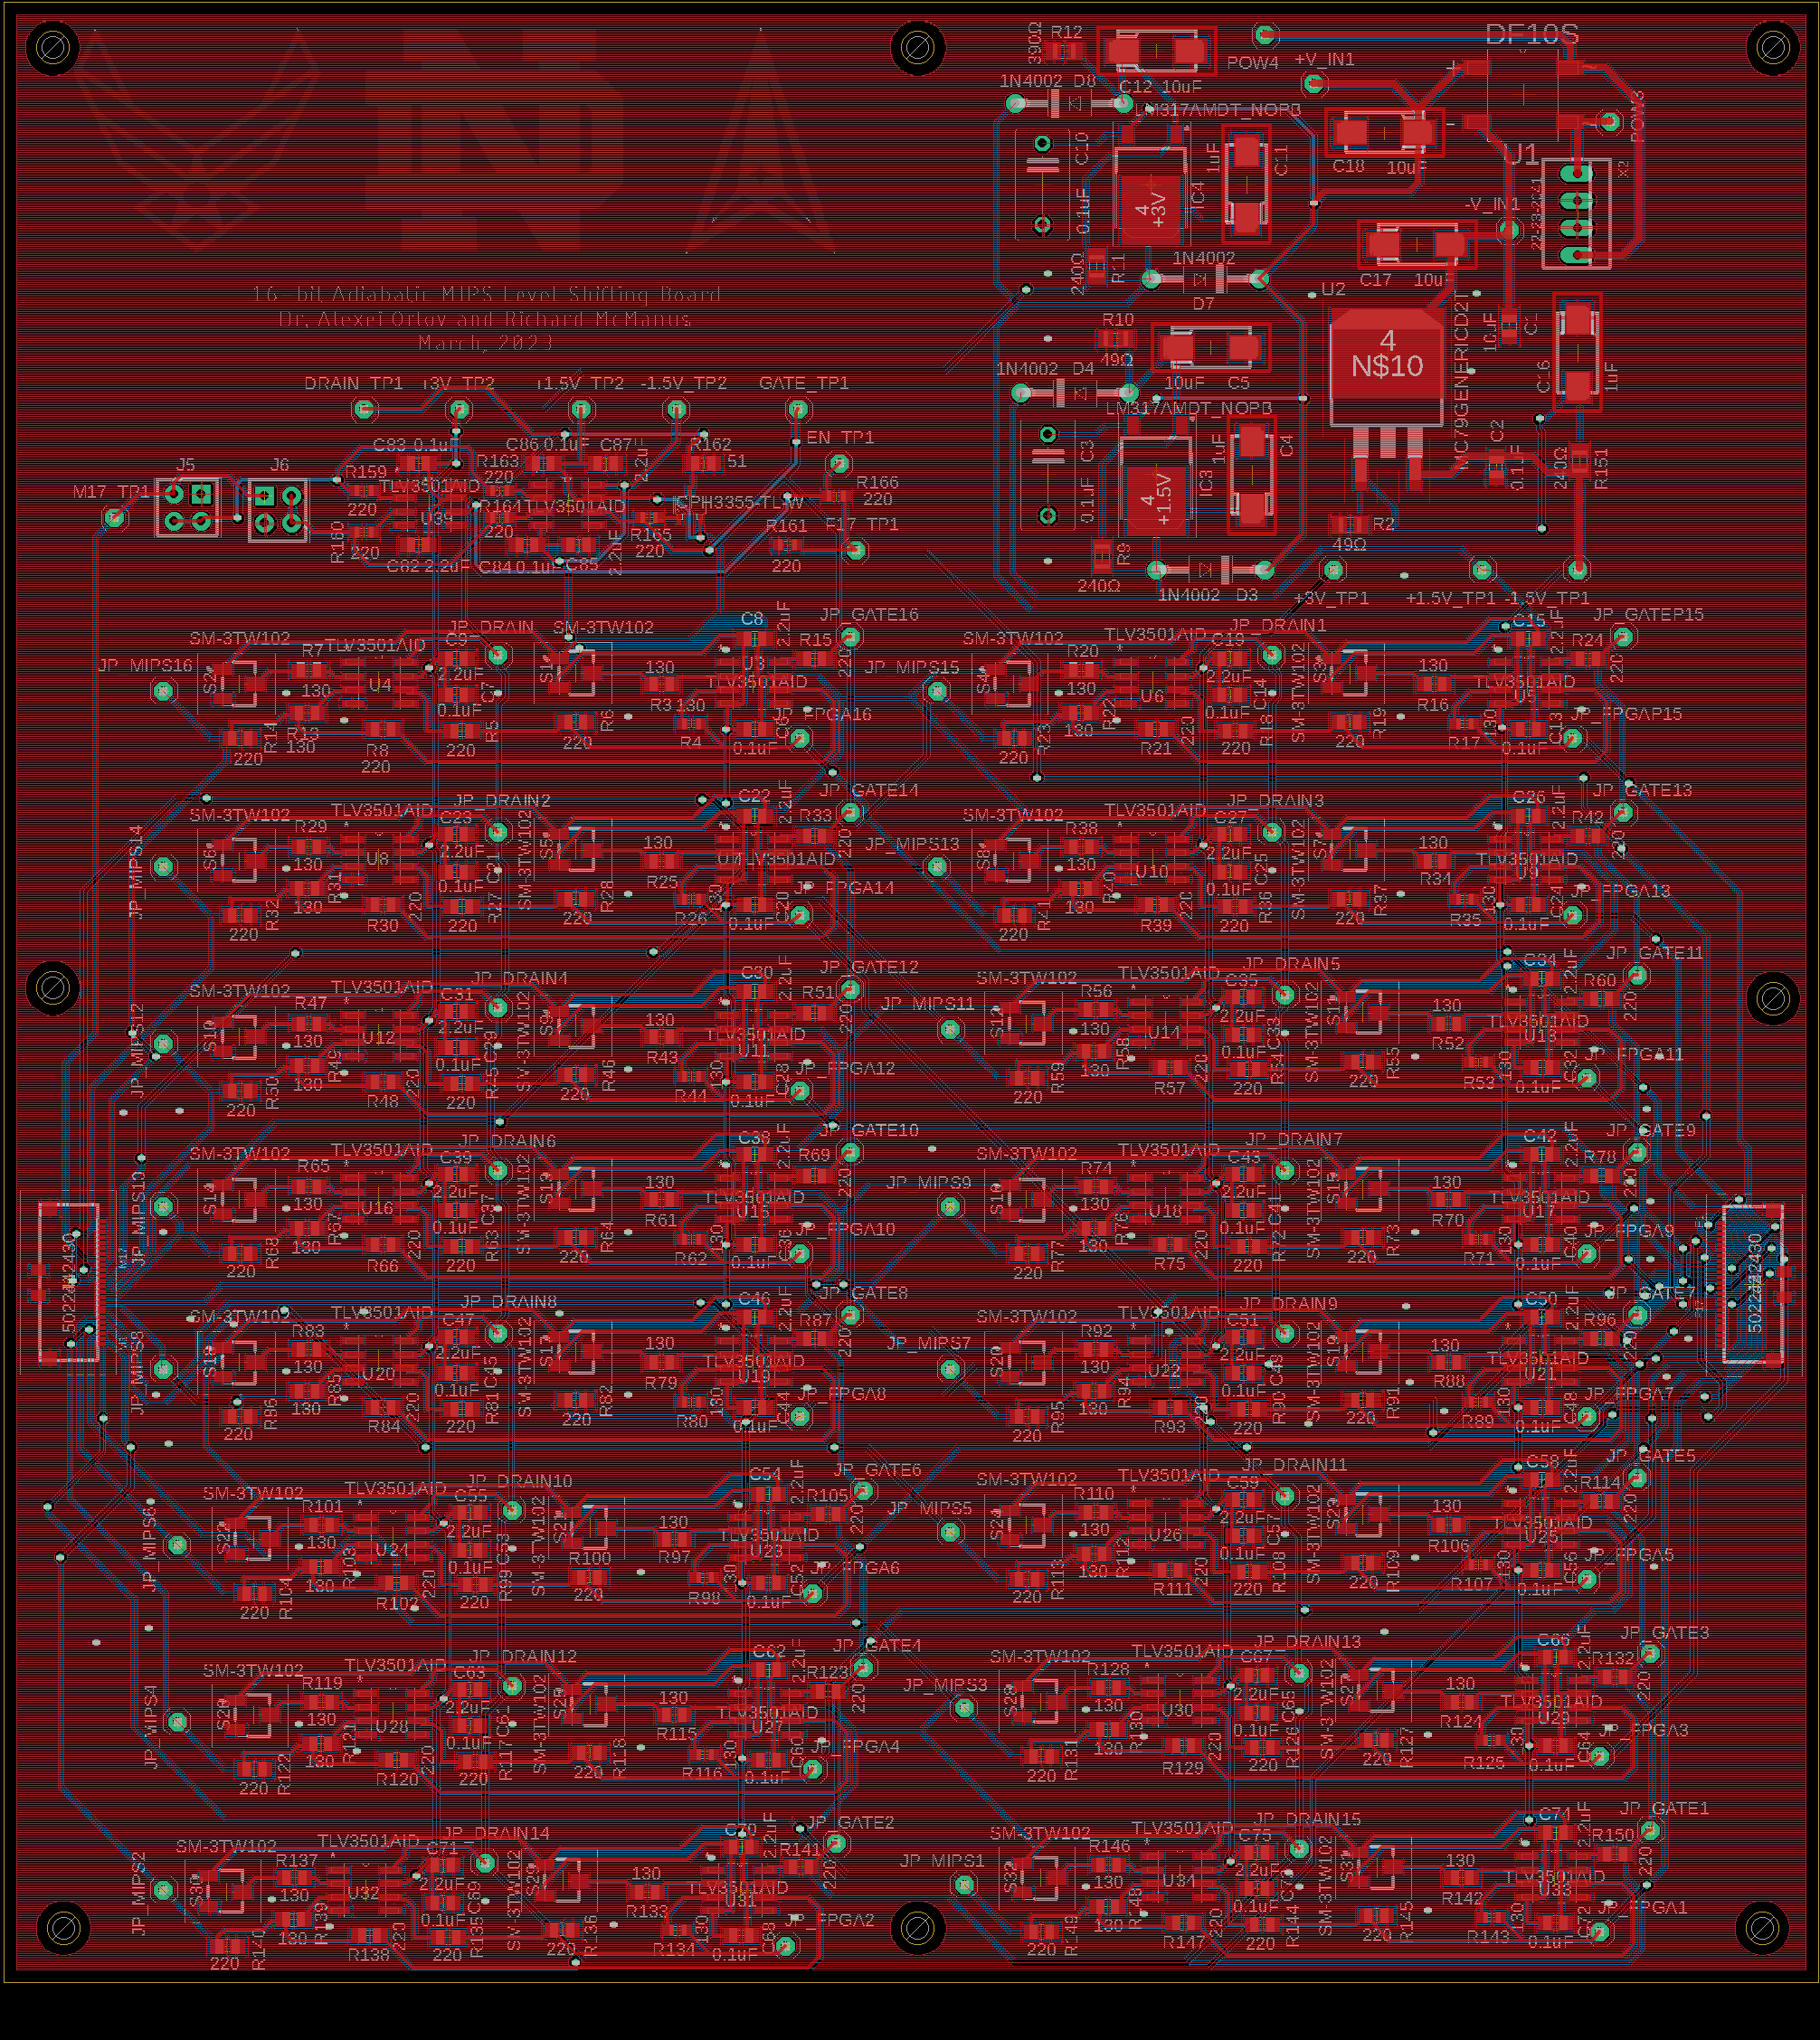
LLS_V3_8x2_Inline
Discovered Design Blocks
Can copy and paste a pre-laid out circuit
Caveat: cannot change design block after implementation
Dr. Orlov laid out board
Helped with warnings and errors
Organized silkscreen
Compressed board
Ordered board from Elecrow

Slide 40
Communication and Collaboration

Slide 41
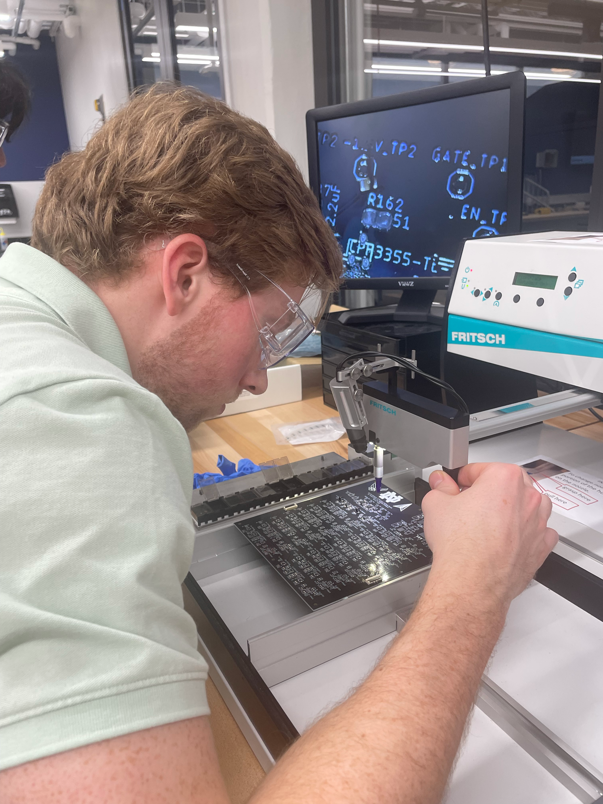
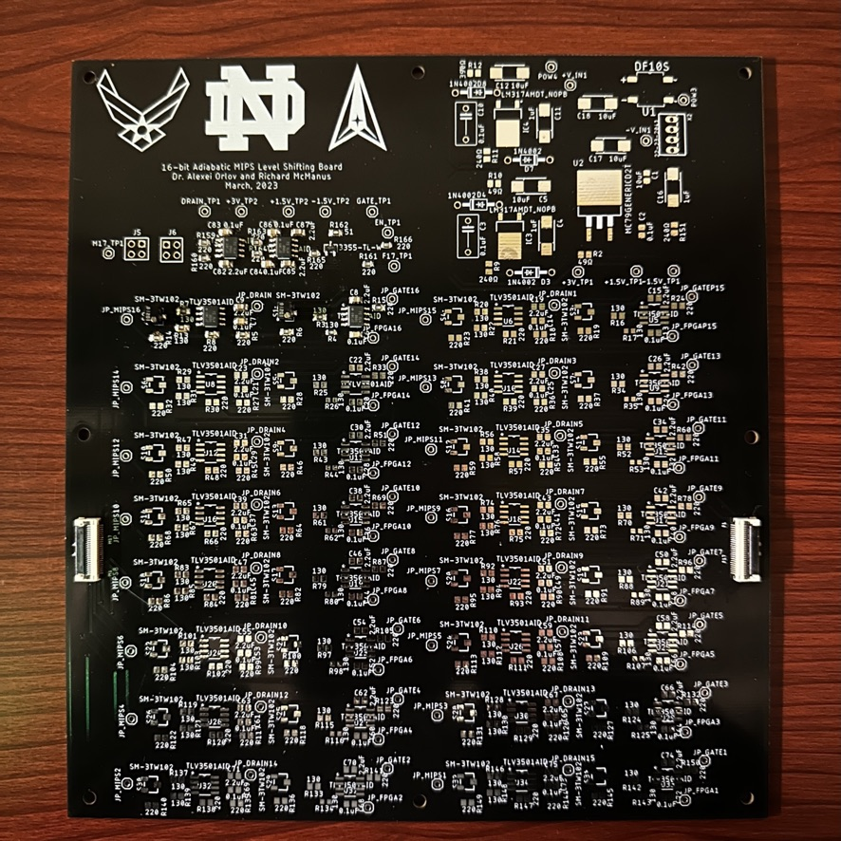
LLS_V3_8x2_Inline Assembly
Assembled 1 channel with Ricky

Slide 42
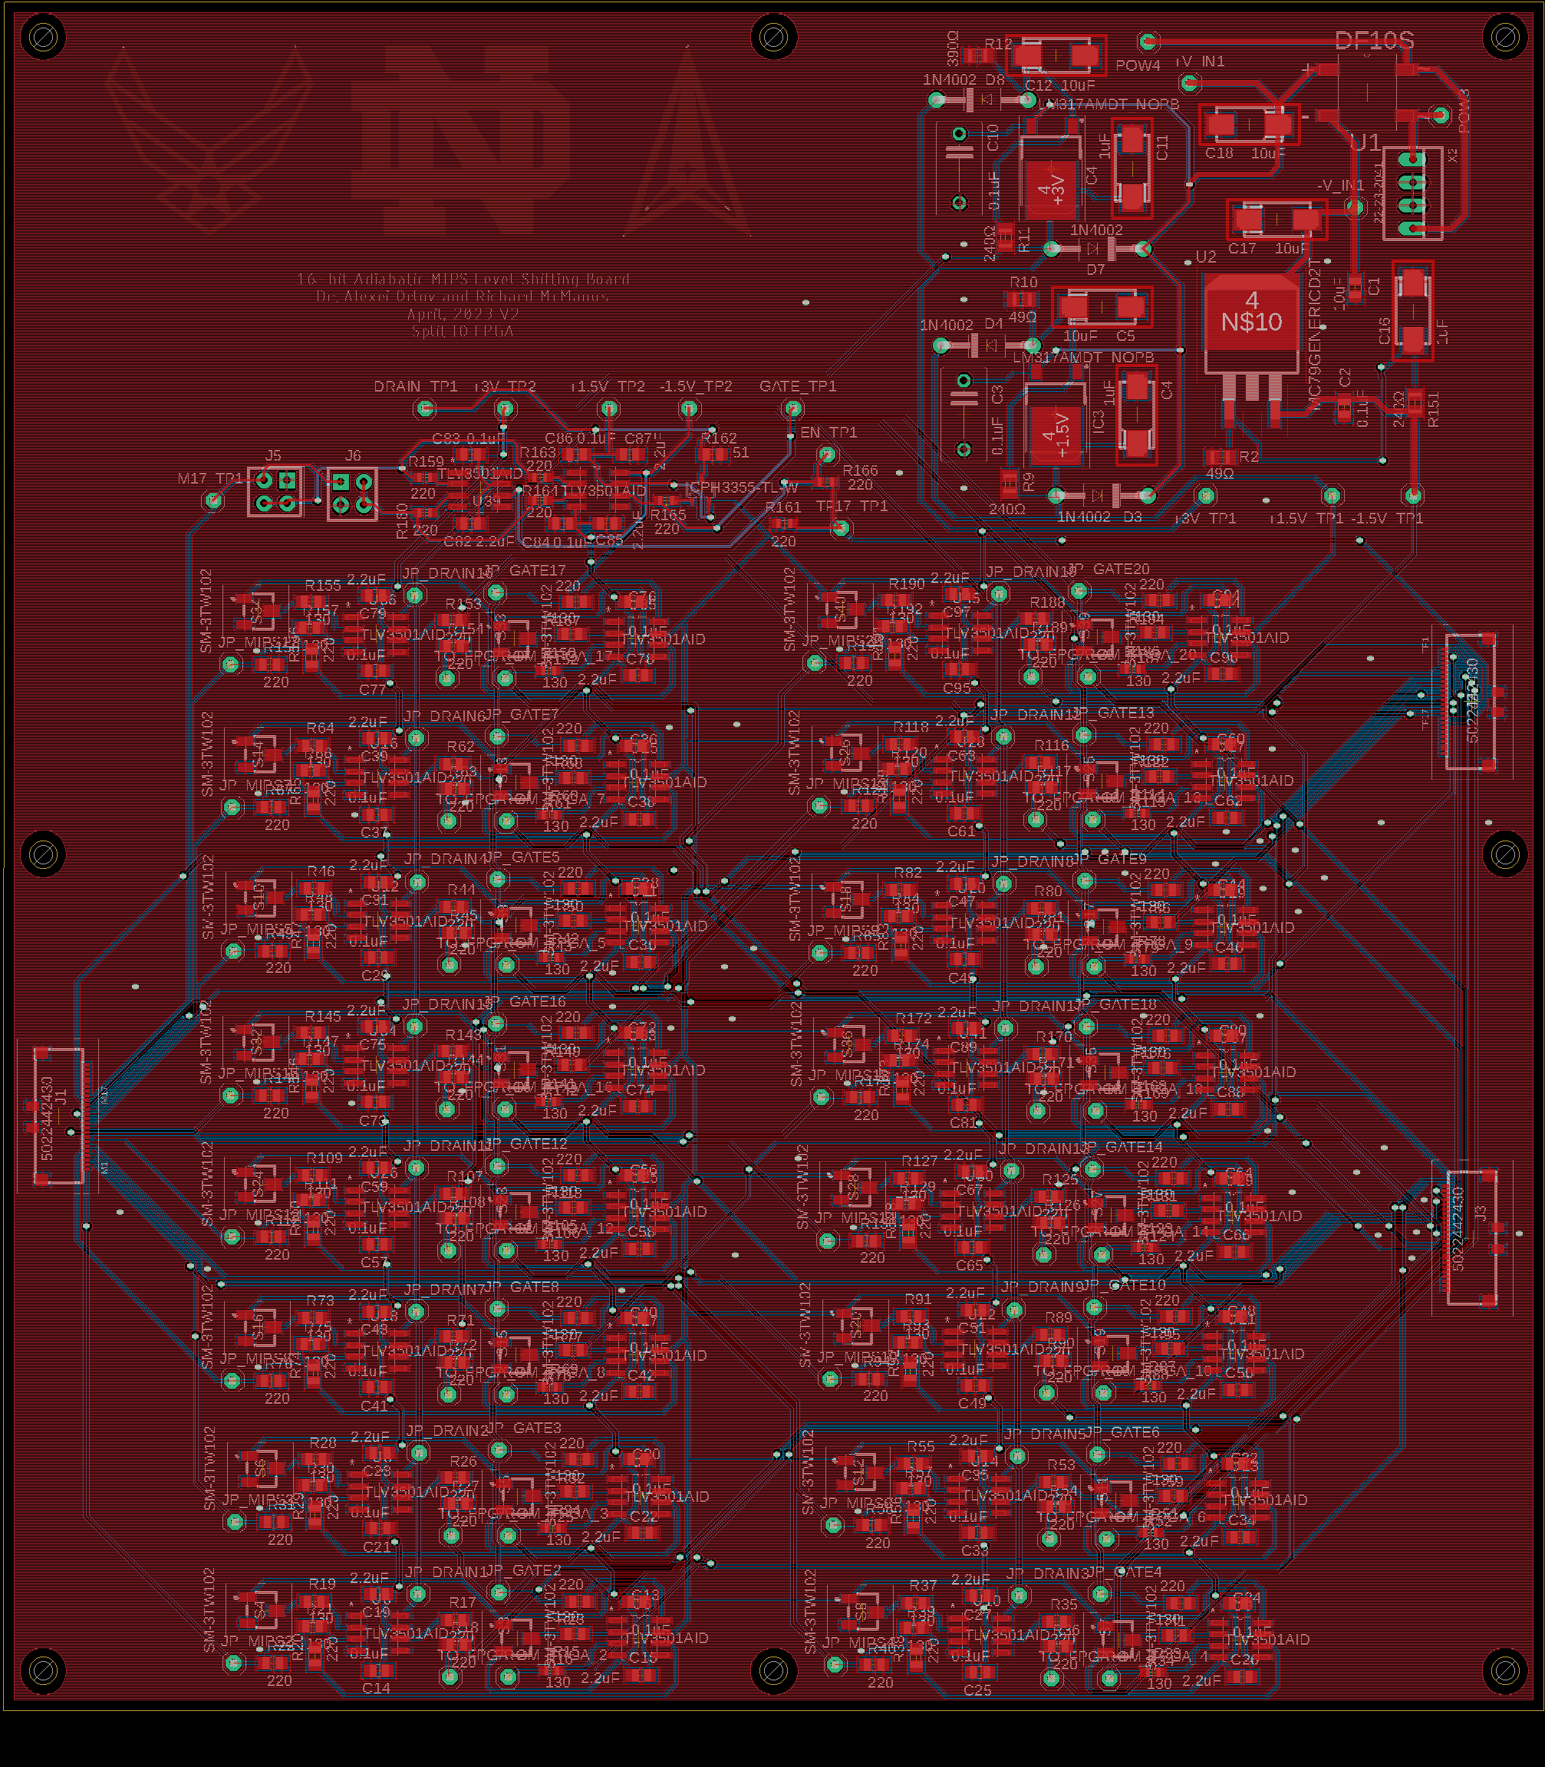
LLS_V4_8x2_Inline
Dr. Orlov implemented 2 – pin bi-directional design
Helped with warnings and errors
Ordered board from Elecrow

Slide 43
Next Steps
Assemble Boards (In EIH)
Test functionality

